Slide 1
Appendix A
Instruction Set Principles

Slide 2
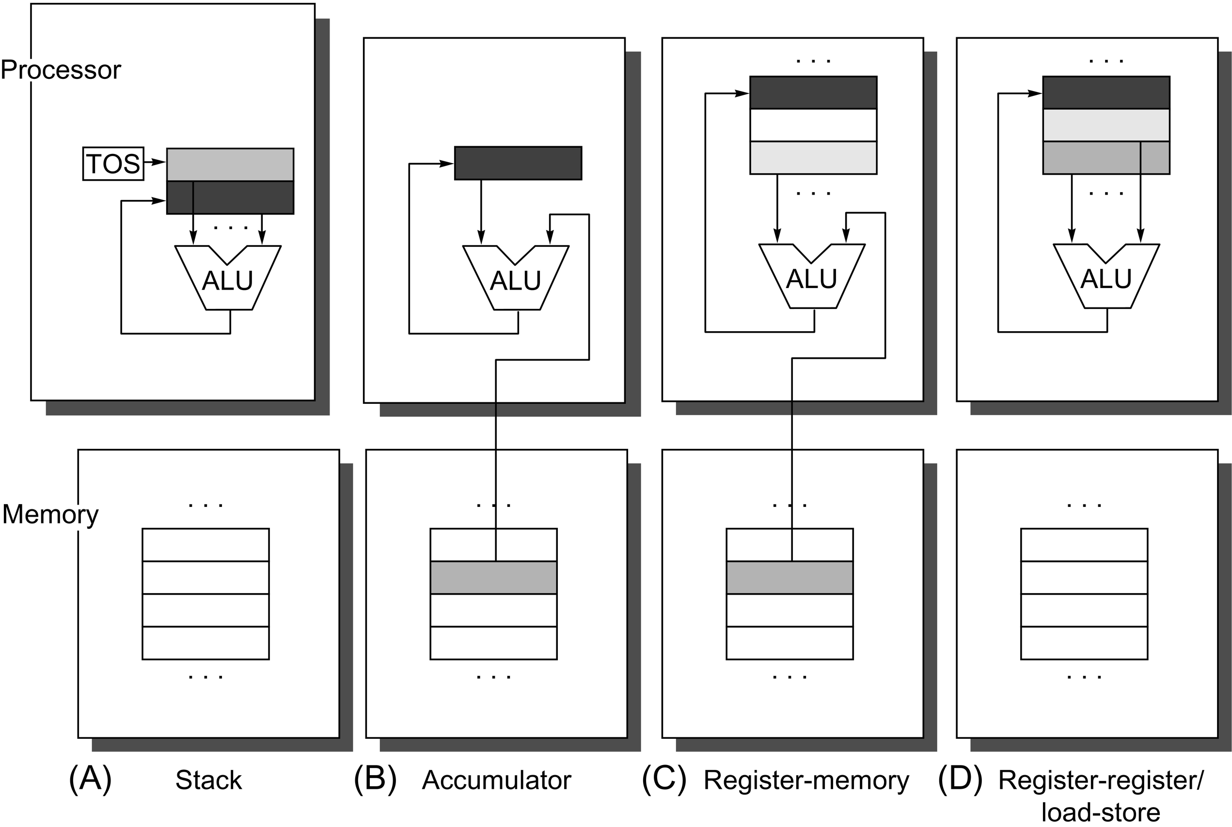
Figure A.1 Operand locations for four instruction set architecture classes. The arrows indicate whether the operand is an input or the result of the arithmetic-logical unit (ALU) operation, or both an input and result. Lighter shades indicate inputs, and the dark shade indicates the result. In (A), a top of stack (TOS) register points to the top input operand, which is combined with the operand below. The first operand is removed from the stack, the result takes the place of the second operand, and TOS is updated to point to the result. All operands are implicit. In (B), the accumulator is both an implicit input operand and a result. In (C), one input operand is a register, one is in memory, and the result goes to a register. All operands are registers in (D) and, like the stack architecture, can be transferred to memory only via separate instructions: push or pop for (A) and load or store for (D).

Slide 3
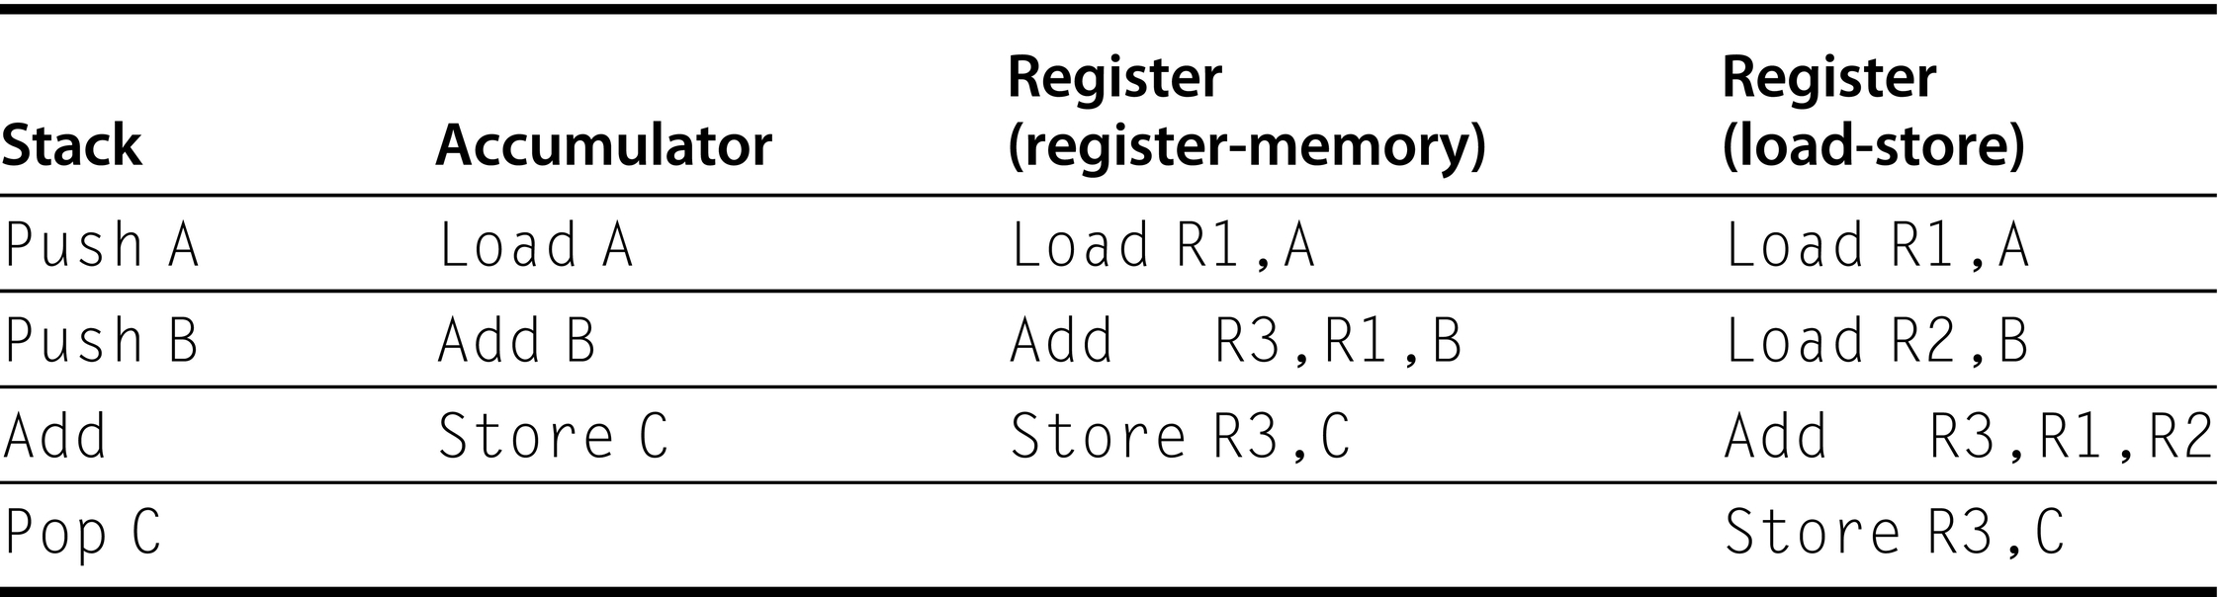
Figure A.2 The code sequence for C = A + B for four classes of instruction sets. Note that the Add instruction has implicit operands for stack and accumulator architectures and explicit operands for register architectures. It is assumed that A, B, and C all belong in memory and that the values of A and B cannot be destroyed. Figure A.1 shows the Add operation for each class of architecture.

Slide 4
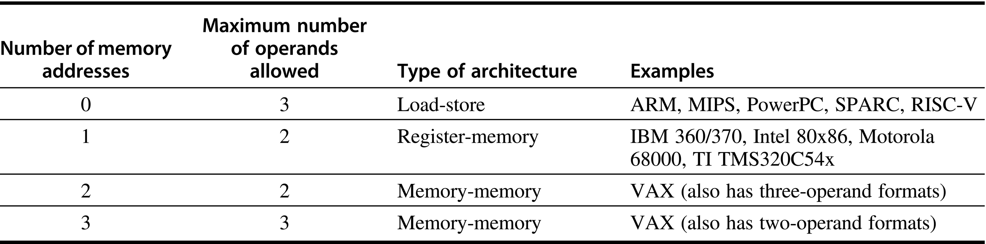
Figure A.3 Typical combinations of memory operands and total operands per typical ALU instruction with examples of computers. Computers with no memory reference per ALU instruction are called load-store or register-register computers. Instructions with multiple memory operands per typical ALU instruction are called register-memory or memory-memory, according to whether they have one or more than one memory operand.

Slide 5
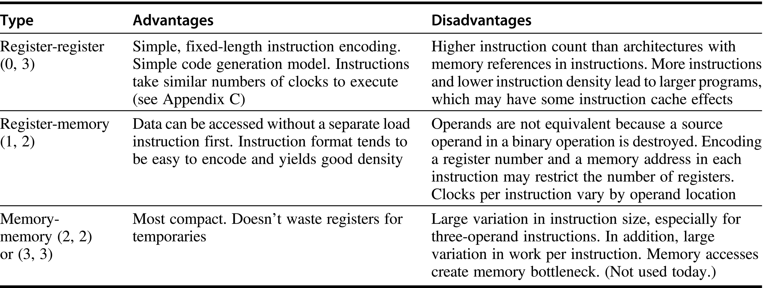
Figure A.4 Advantages and disadvantages of the three most common types of general-purpose register computers. The notation (m, n) means m memory operands and n total operands. In general, computers with fewer alternatives simplify the compiler’s task because there are fewer decisions for the compiler to make (see Section A.8). Computers with a wide variety of flexible instruction formats reduce the number of bits required to encode the program. The number of registers also affects the instruction size because you need log₂ (number of registers) for each register specifier in an instruction. Thus, doubling the number of registers takes three extra bits for a register-register architecture, or about 10% of a 32-bit instruction.

Slide 6
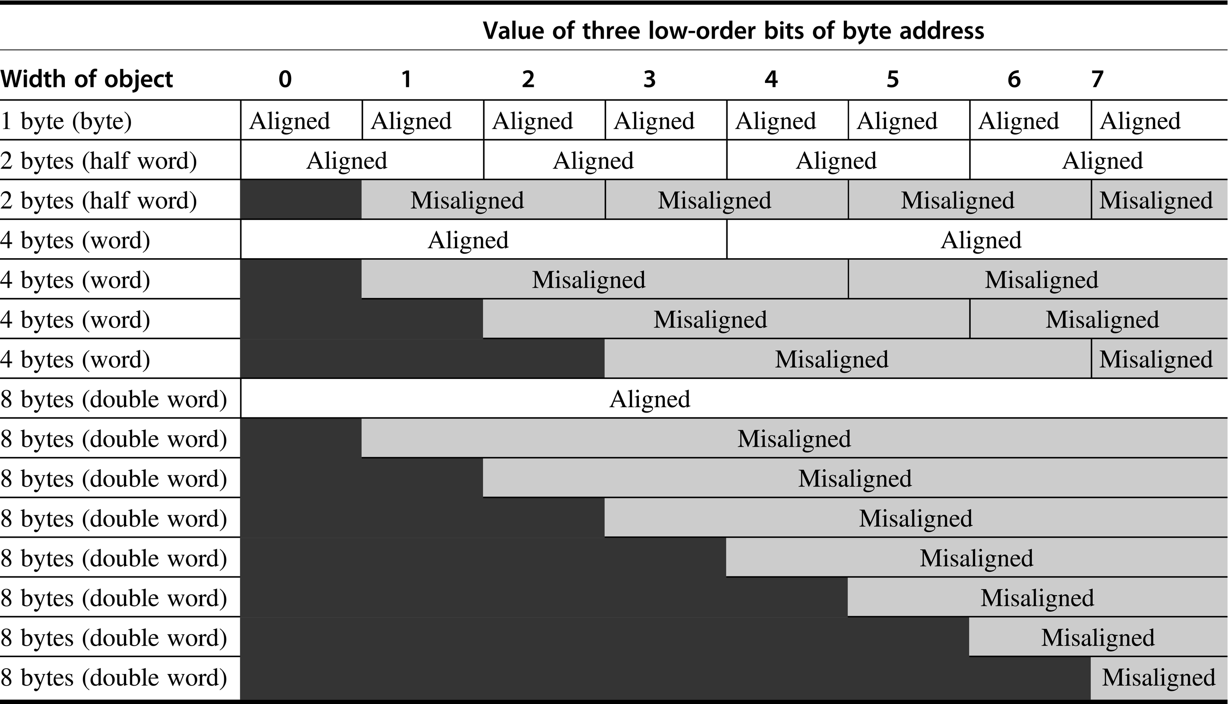
Figure A.5 Aligned and misaligned addresses of byte, half-word, word, and double-word objects for byte-addressed computers. For each misaligned example some objects require two memory accesses to complete. Every aligned object can always complete in one memory access, as long as the memory is as wide as the object. The figure shows the memory organized as 8 bytes wide. The byte offsets that label the columns specify the low-order three bits of the address.

Slide 7
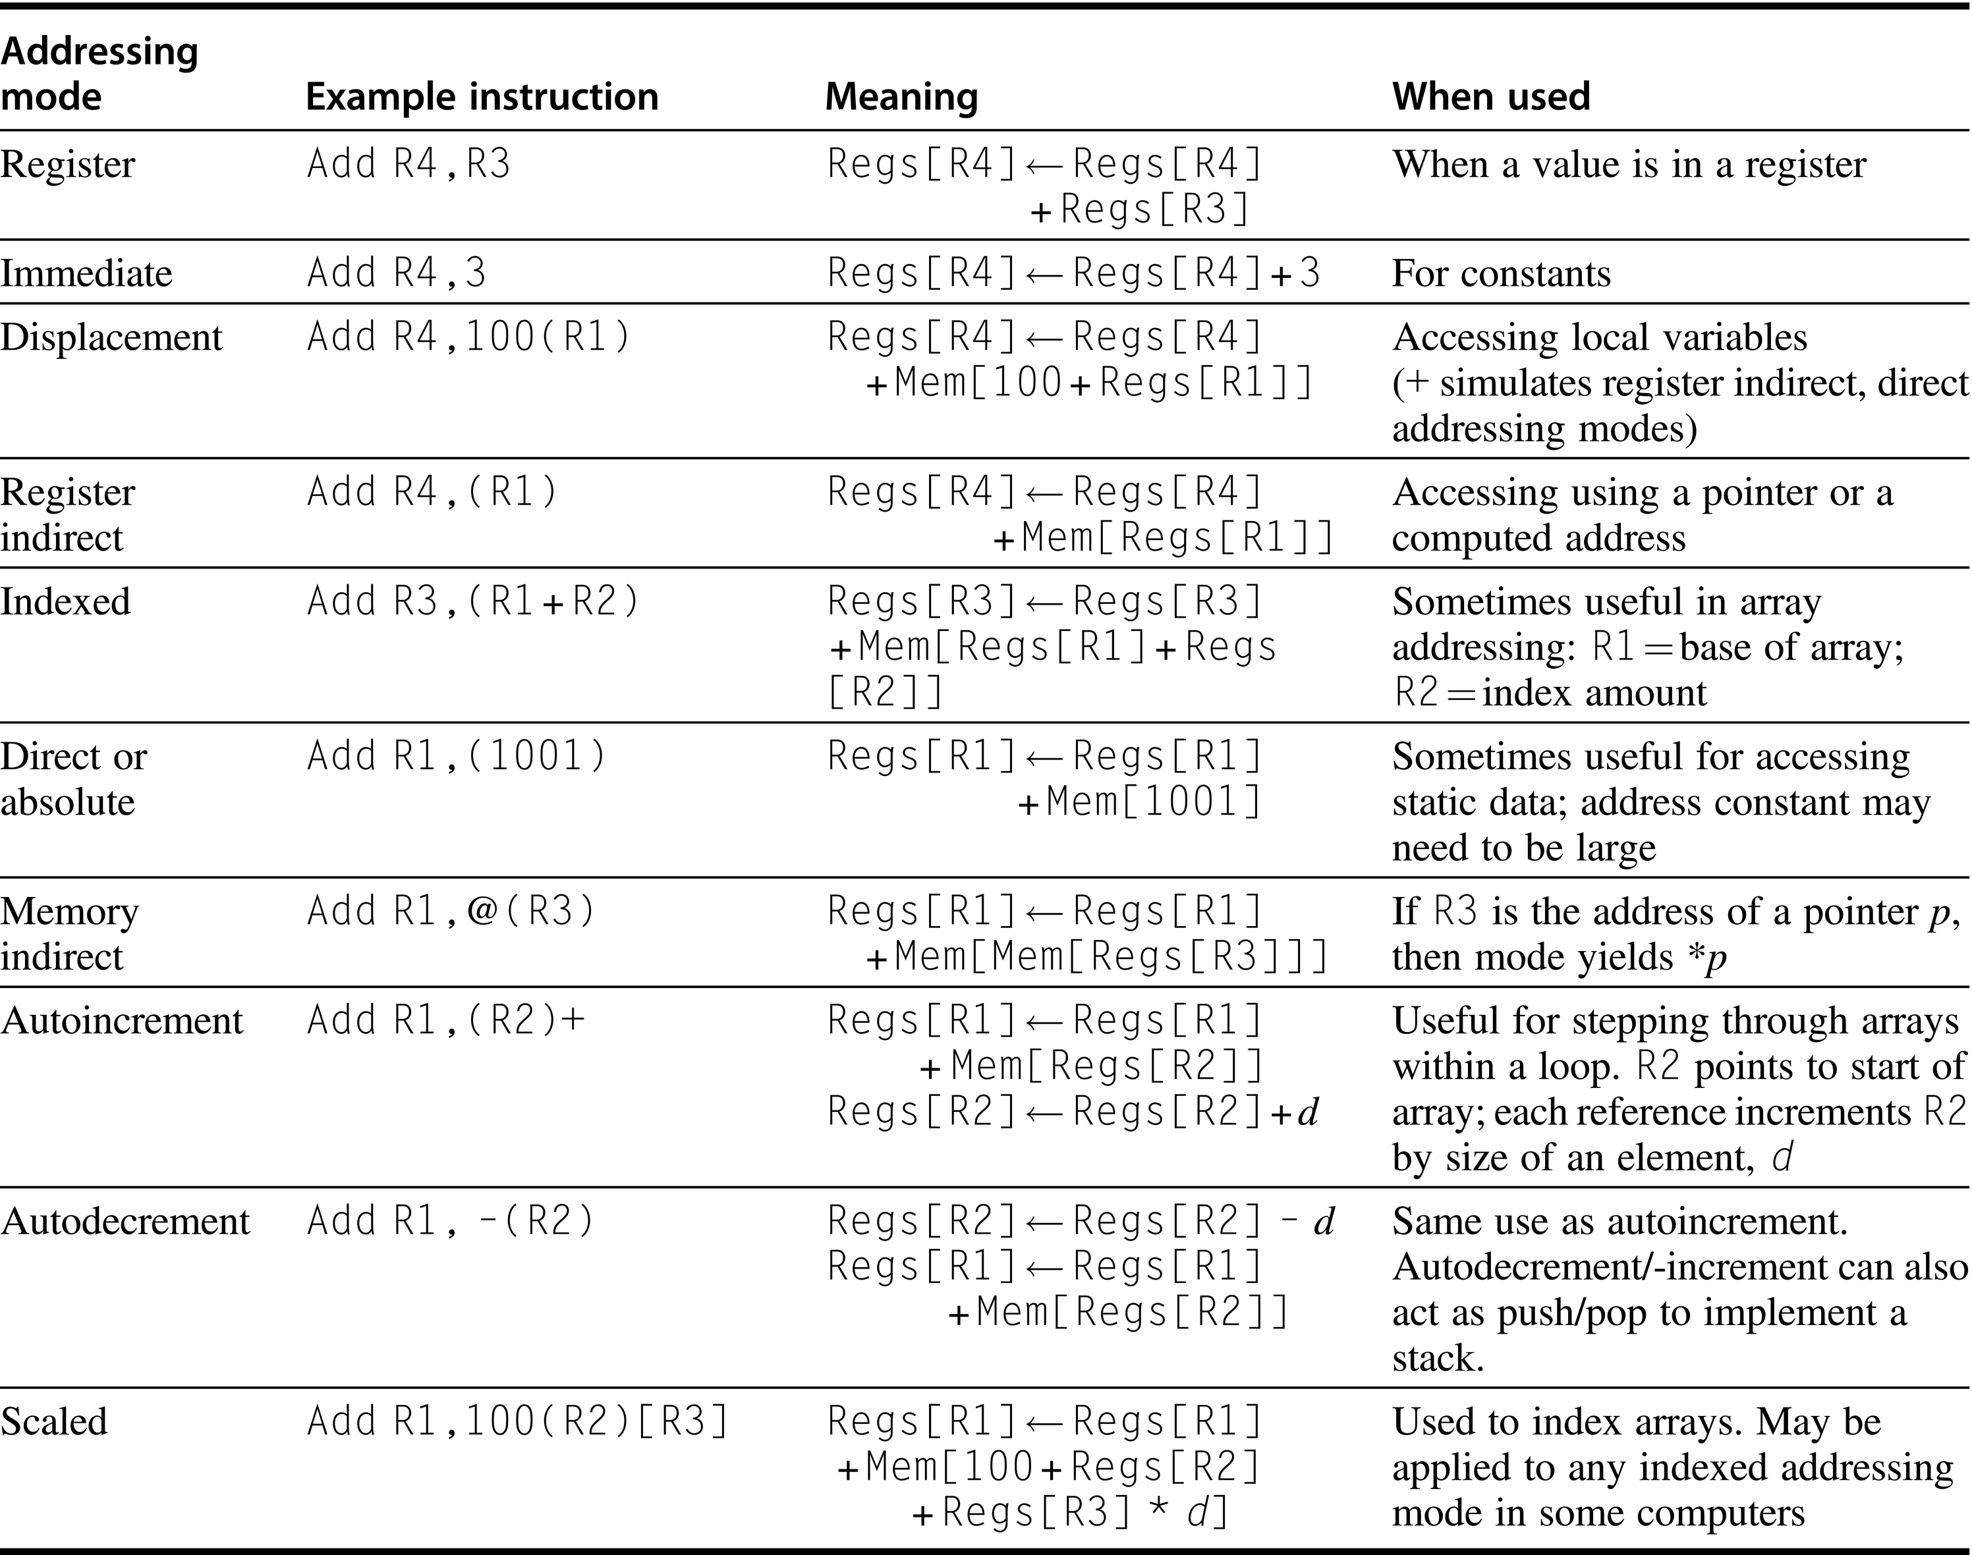
Figure A.6 Selection of addressing modes with examples, meaning, and usage. In autoincrement/-decrement and scaled addressing modes, the variable d designates the size of the data item being accessed (i.e., whether the instruction is accessing 1, 2, 4, or 8 bytes). These addressing modes are only useful when the elements being accessed are adjacent in memory. RISC computers use displacement addressing to simulate register indirect with 0 for the address and to simulate direct addressing using 0 in the base register. In our measurements, we use the first name shown for each mode. The extensions to C used as hardware descriptions are defined on page A.38.

Slide 8
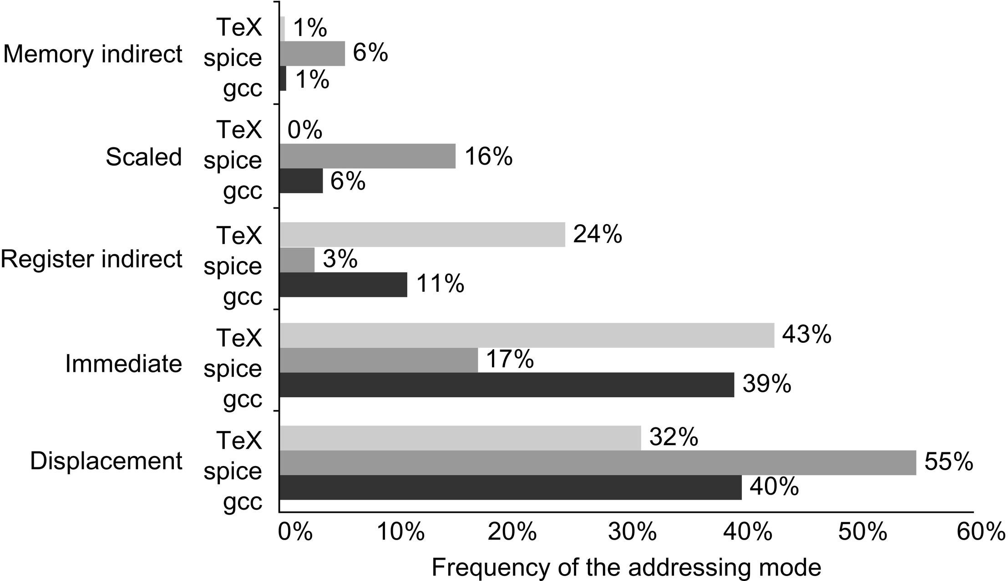
Figure A.7 Summary of use of memory addressing modes (including immediates). These major addressing modes account for all but a few percent (0%–3%) of the memory accesses. Register modes, which are not counted, account for one-half of the operand references, while memory addressing modes (including immediate) account for the other half. Of course, the compiler affects what addressing modes are used; see Section A.8. The memory indirect mode on the VAX can use displacement, autoincrement, or autodecrement to form the initial memory address; in these programs, almost all the memory indirect references use displacement mode as the base. Displacement mode includes all displacement lengths (8, 16, and 32 bits). The PC-relative addressing modes, used almost exclusively for branches, are not included. Only the addressing modes with an average frequency of over 1% are shown.

Slide 9
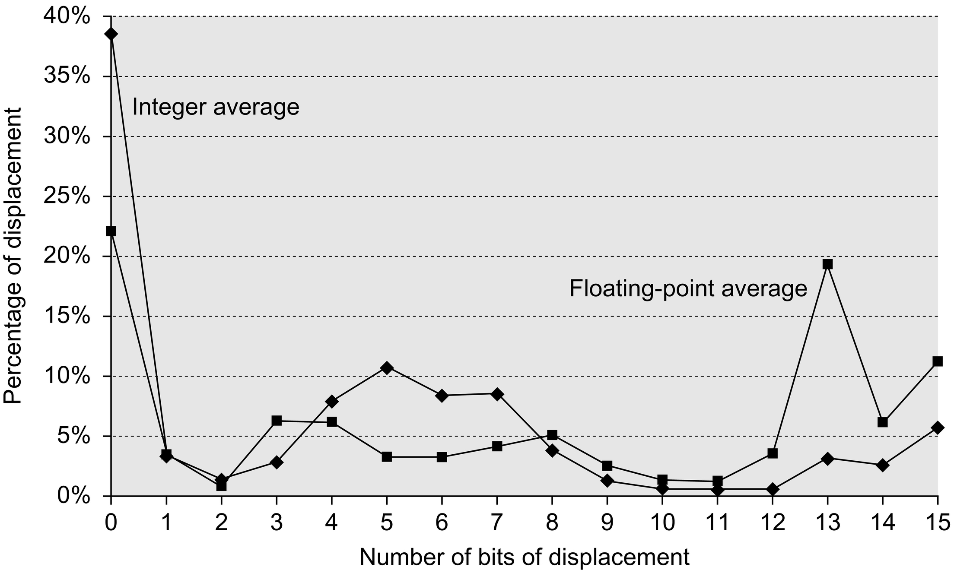
Figure A.8 Displacement values are widely distributed. There are both a large number of small values and a fair number of large values. The wide distribution of displacement values is due to multiple storage areas for variables and different displacements to access them (see Section A.8) as well as the overall addressing scheme the compiler uses. The x-axis is log₂ of the displacement, that is, the size of a field needed to represent the magnitude of the displacement. Zero on the x-axis shows the percentage of displacements of value 0. The graph does not include the sign bit, which is heavily affected by the storage layout. Most displacements are positive, but a majority of the largest displacements (14 + bits) are negative. Because these data were collected on a computer with 16-bit displacements, they cannot tell us about longer displacements. These data were taken on the Alpha architecture with full optimization (see Section A.8) for SPEC CPU2000, showing the average of integer programs (CINT2000) and the average of floating-point programs (CFP2000).

Slide 10
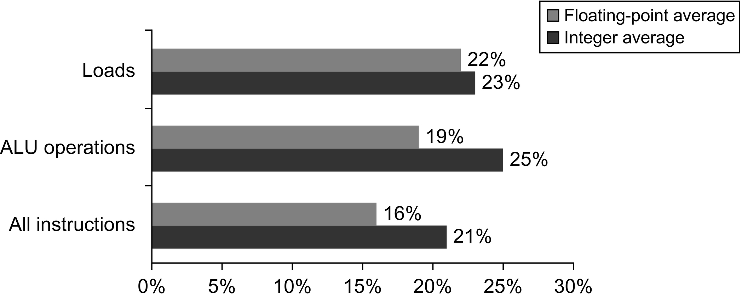
Figure A.9 About one-quarter of data transfers and ALU operations have an immediate operand. The bottom bars show that integer programs use immediates in about one-fifth of the instructions, while floating-point programs use immediates in about one-sixth of the instructions. For loads, the load immediate instruction loads 16 bits into either half of a 32-bit register. Load immediates are not loads in a strict sense because they do not access memory. Occasionally a pair of load immediates is used to load a 32-bit constant, but this is rare. (For ALU operations, shifts by a constant amount are included as operations with immediate operands.) The programs and computer used to collect these statistics are the same as in Figure A.8.

Slide 11
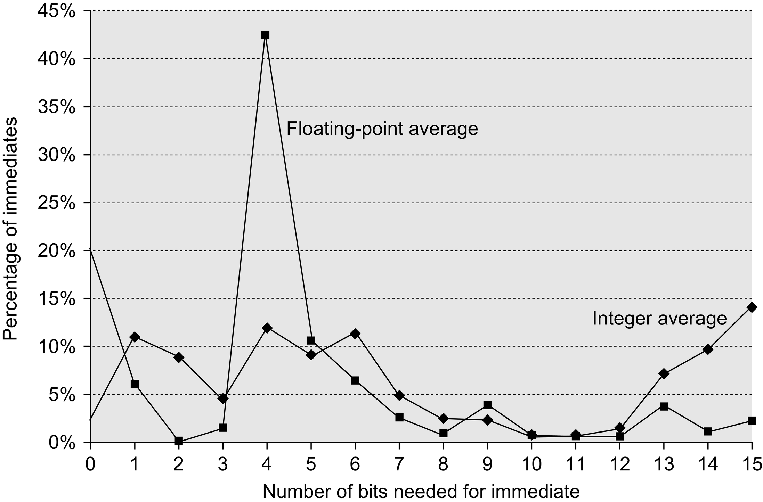
Figure A.10 The distribution of immediate values. The x-axis shows the number of bits needed to represent the magnitude of an immediate value—0 means the immediate field value was 0. The majority of the immediate values are positive. About 20% were negative for CINT2000, and about 30% were negative for CFP2000. These measurements were taken on an Alpha, where the maximum immediate is 16 bits, for the same programs as in Figure A.8. A similar measurement on the VAX, which supported 32-bit immediates, showed that about 20%–25% of immediates were longer than 16 bits. Thus, 16 bits would capture about 80% and 8 bits about 50%.

Slide 12
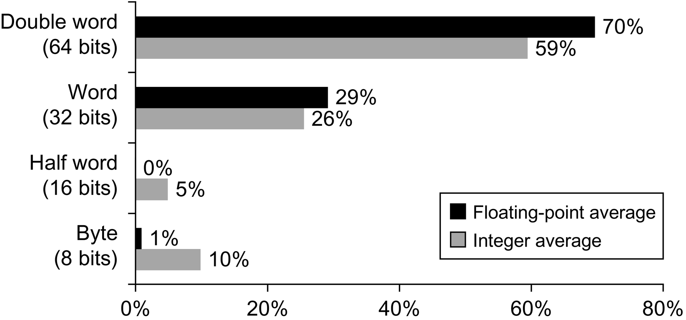
Figure A.11 Distribution of data accesses by size for the benchmark programs. The double-word data type is used for double-precision floating point in floating-point programs and for addresses, because the computer uses 64-bit addresses. On a 32-bit address computer the 64-bit addresses would be replaced by 32-bit addresses, and so almost all double-word accesses in integer programs would become single-word accesses.

Slide 13
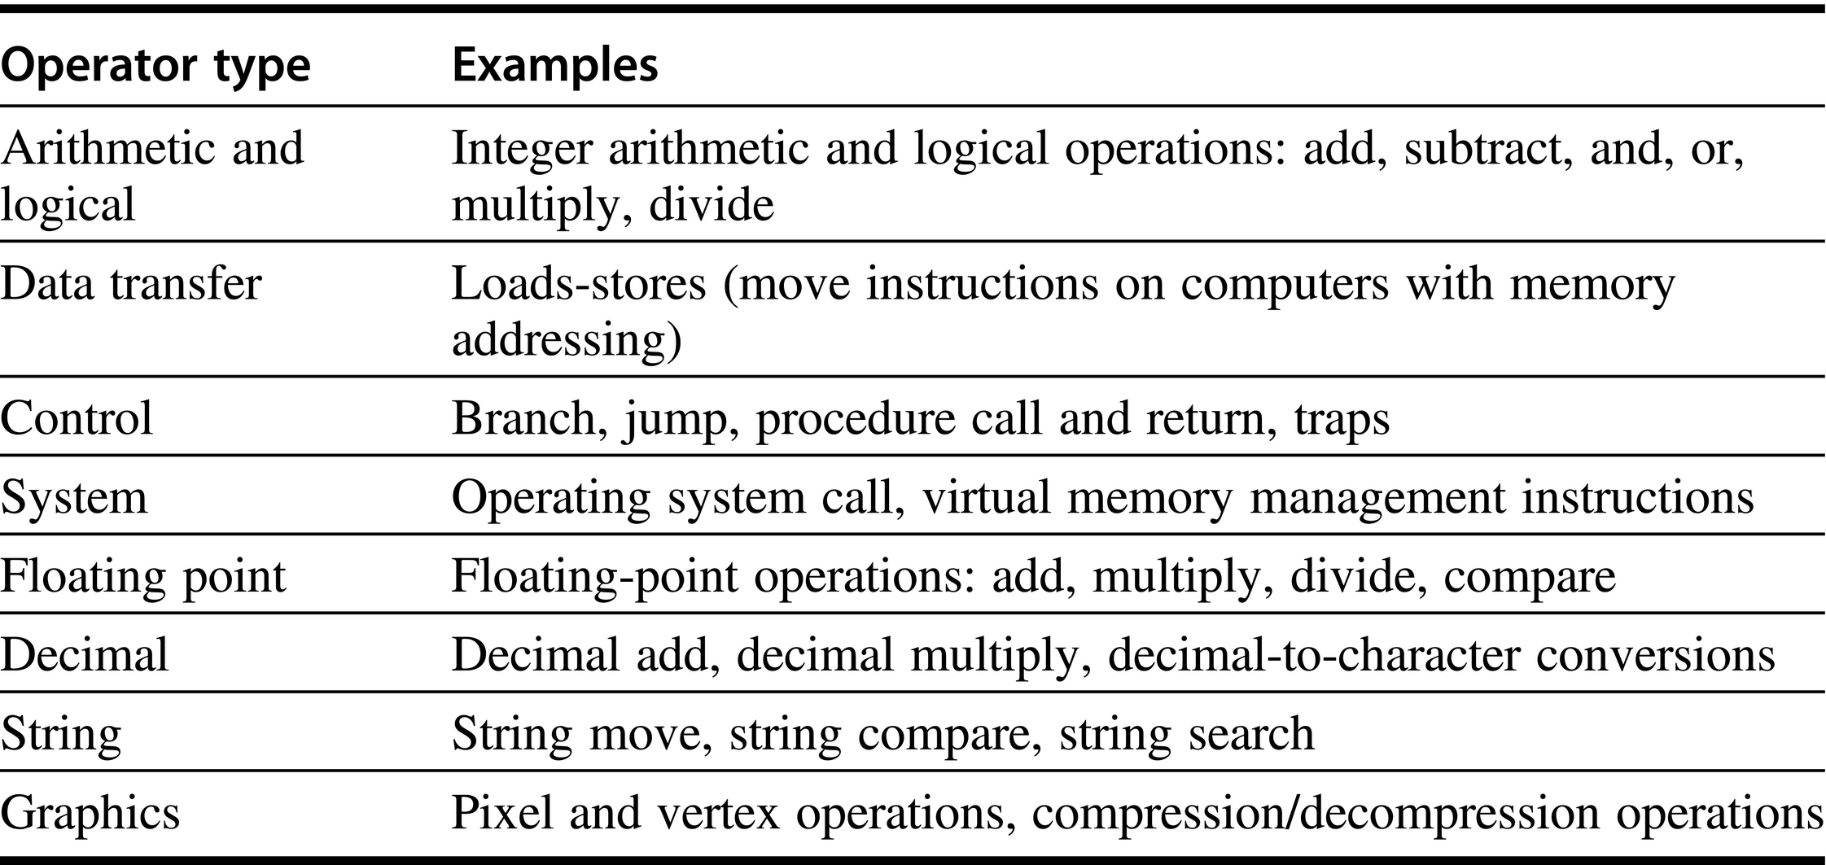
Figure A.12 Categories of instruction operators and examples of each. All computers generally provide a full set of operations for the first three categories. The support for system functions in the instruction set varies widely among architectures, but all computers must have some instruction support for basic system functions. The amount of support in the instruction set for the last four categories may vary from none to an extensive set of special instructions. Floating-point instructions will be provided in any computer that is intended for use in an application that makes much use of floating point. These instructions are sometimes part of an optional instruction set. Decimal and string instructions are sometimes primitives, as in the VAX or the IBM 360, or may be synthesized by the compiler from simpler instructions. Graphics instructions typically operate on many smaller data items in parallel—for example, performing eight 8-bit additions on two 64-bit operands.

Slide 14
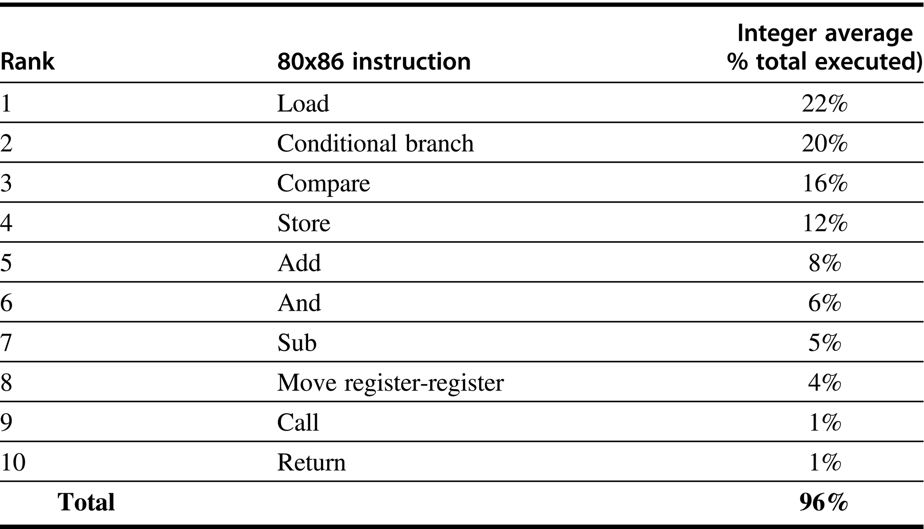
Figure A.13 The top 10 instructions for the 80x86. Simple instructions dominate this list and are responsible for 96% of the instructions executed. These percentages are the average of the five SPECint92 programs.

Slide 15
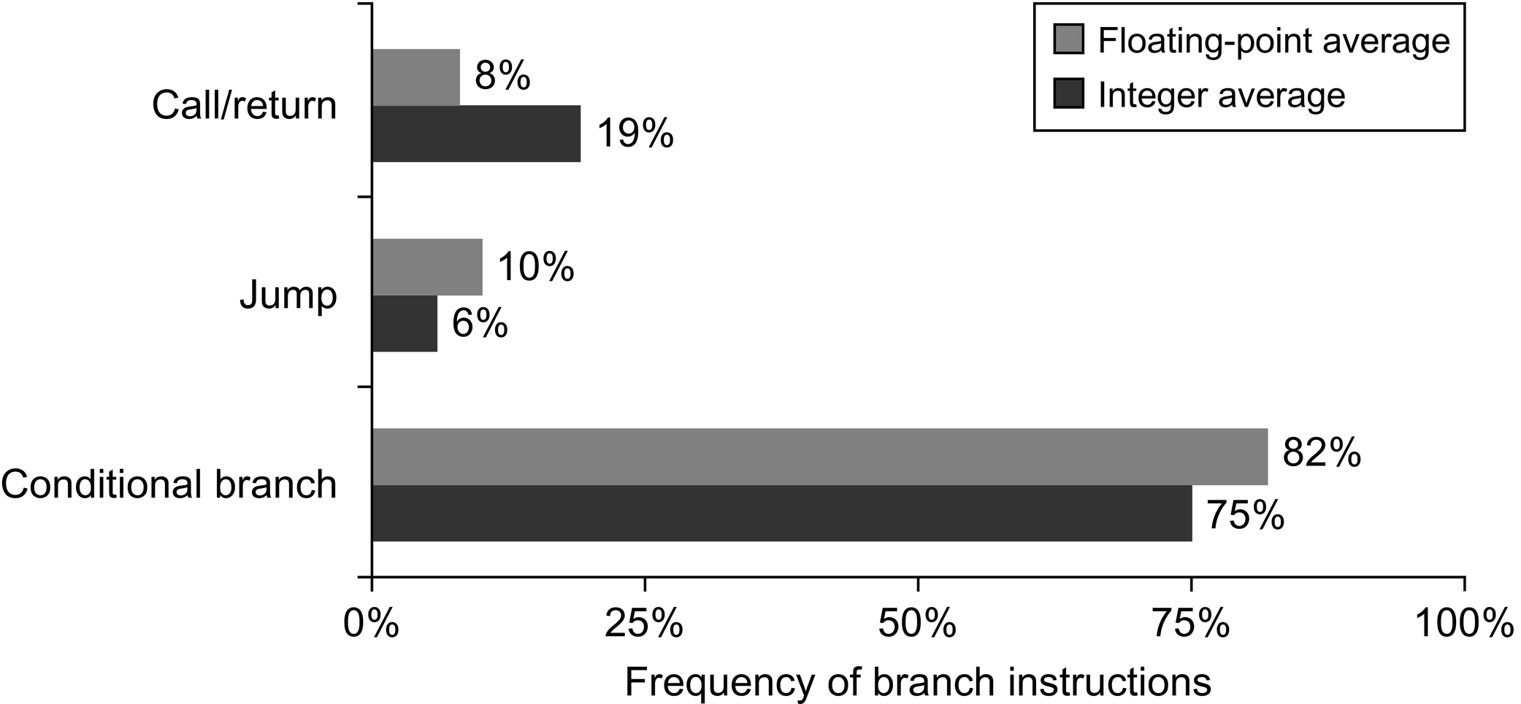
Figure A.14 Breakdown of control flow instructions into three classes: calls or returns, jumps, and conditional branches. Conditional branches clearly dominate. Each type is counted in one of three bars. The programs and computer used to collect these statistics are the same as those in Figure A.8.

Slide 16
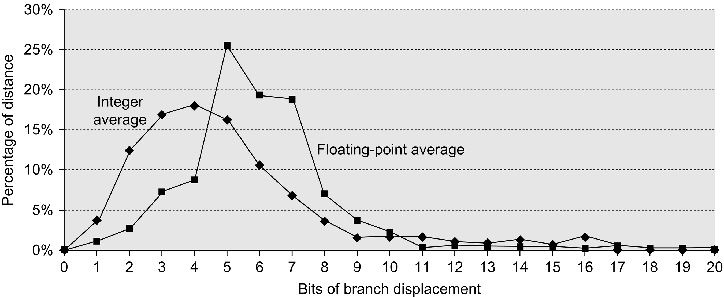
Figure A.15 Branch distances in terms of number of instructions between the target and the branch instruction.
The most frequent branches in the integer programs are to targets that can be encoded in 4–8 bits. This result tells us that short displacement fields often suffice for branches and that the designer can gain some encoding density by having a shorter instruction with a smaller branch displacement. These measurements were taken on a load-store computer (Alpha architecture) with all instructions aligned on word boundaries. An architecture that requires fewer instructions for the same program, such as a VAX, would have shorter branch distances. However, the number of bits needed for the displacement may increase if the computer has variable-length instructions to be aligned on any byte boundary. The programs and computer used to collect these statistics are the same as those in Figure A.8.

Slide 17
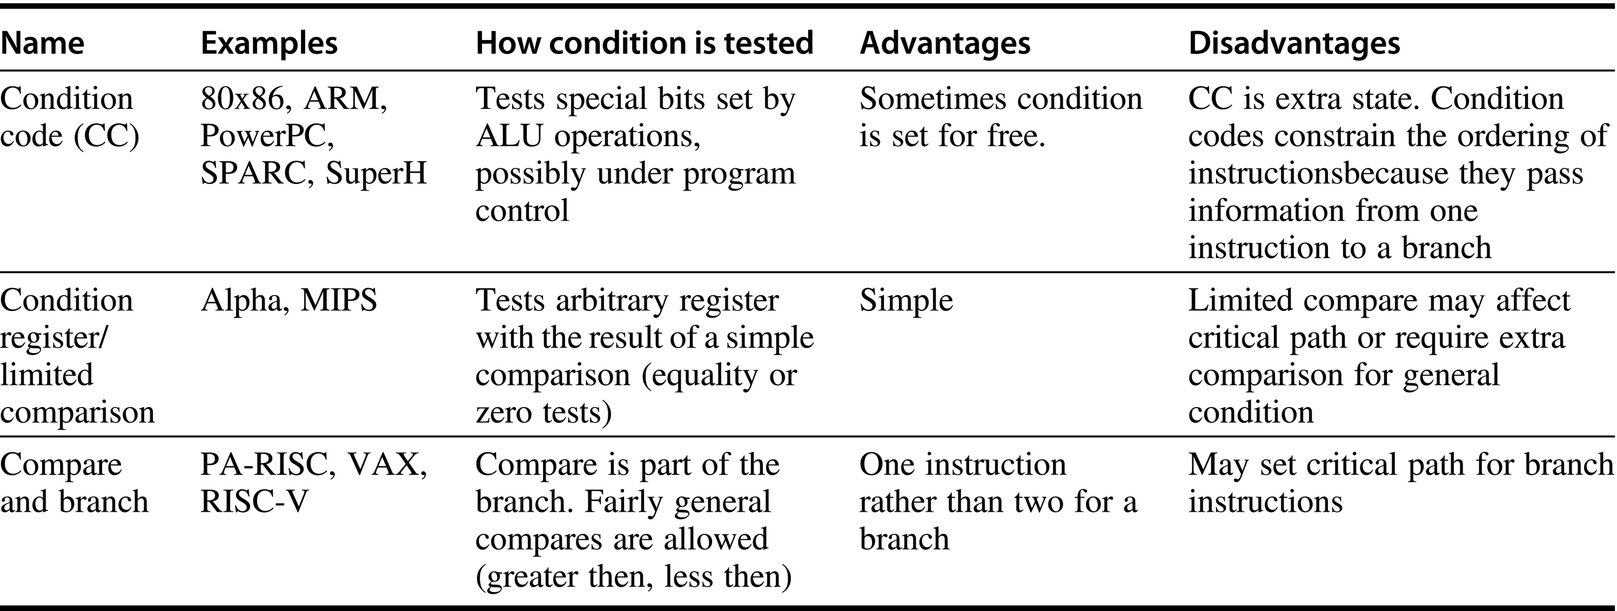
Figure A.16 The major methods for evaluating branch conditions, their advantages, and their disadvantages.
Although condition codes can be set by ALU operations that are needed for other purposes, measurements on programs show that this rarely happens. The major implementation problems with condition codes arise when the condition code is set by a large or haphazardly chosen subset of the instructions, rather than being controlled by a bit in the instruction. Computers with compare and branch often limit the set of compares and use a separate operation and register for more complex compares. Often, different techniques are used for branches based on floating-point comparison versus those based on integer comparison. This dichotomy is reasonable because the number of branches that depend on floating-point comparisons is much smaller than the number depending on integer comparisons.

Slide 18
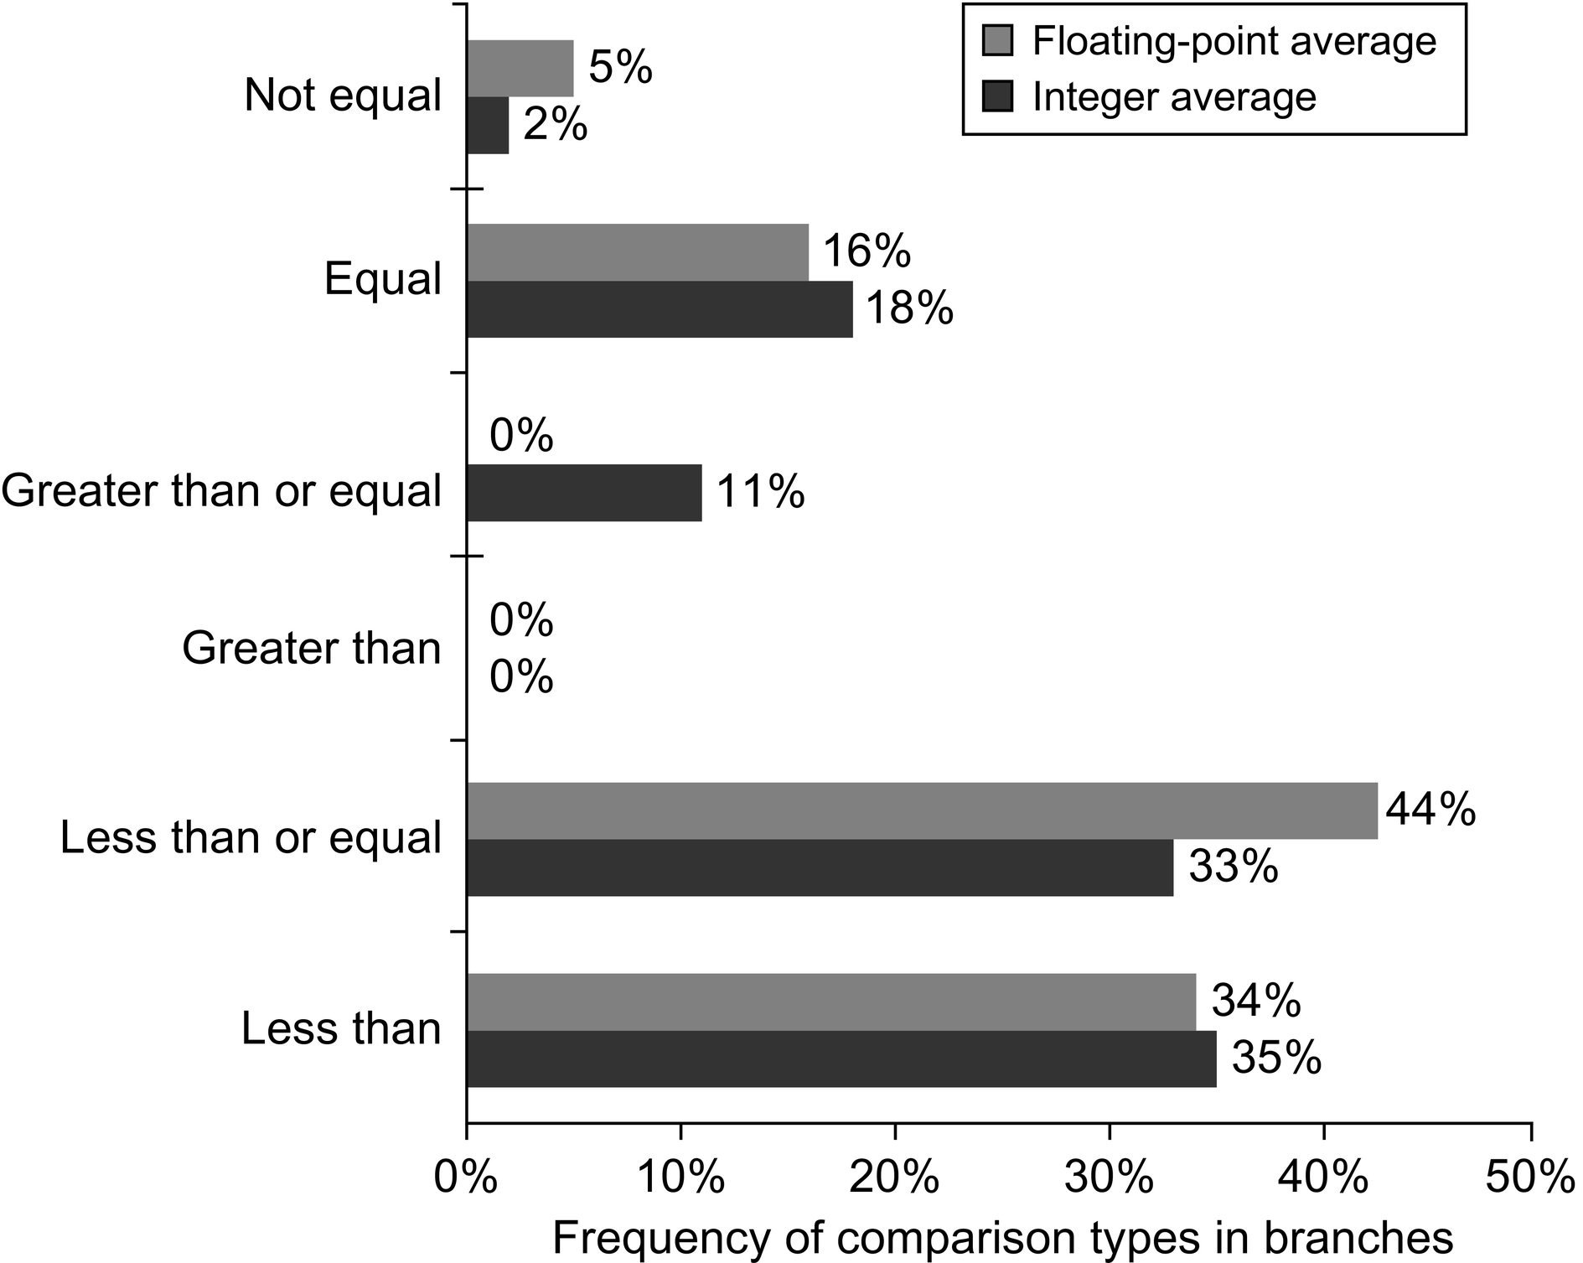
Figure A.17 Frequency of different types of compares in conditional branches. Less than (or equal) branches dominate this combination of compiler and architecture. These measurements include both the integer and floating-point compares in branches. The programs and computer used to collect these statistics are the same as those in Figure A.8.

Slide 19
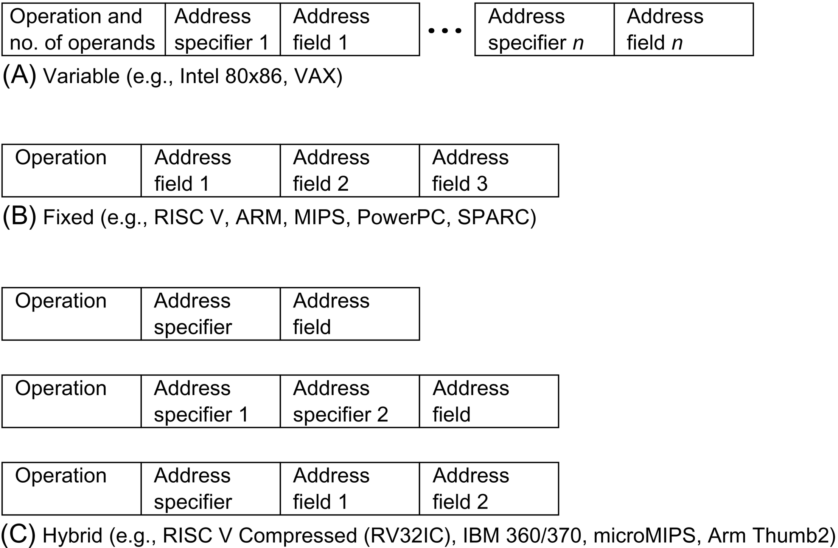
Figure A.18 Three basic variations in instruction encoding: variable length, fixed length, and hybrid. The variable format can support any number of operands, with each address specifier determining the addressing mode and the length of the specifier for that operand. It generally enables the smallest code representation, because unused fields need not be included. The fixed format always has the same number of operands, with the addressing modes (if options exist) specified as part of the opcode. It generally results in the largest code size. Although the fields tend not to vary in their location, they will be used for different purposes by different instructions. The hybrid approach has multiple formats specified by the opcode, adding one or two fields to specify the addressing mode and one or two fields to specify the operand address.

Slide 20
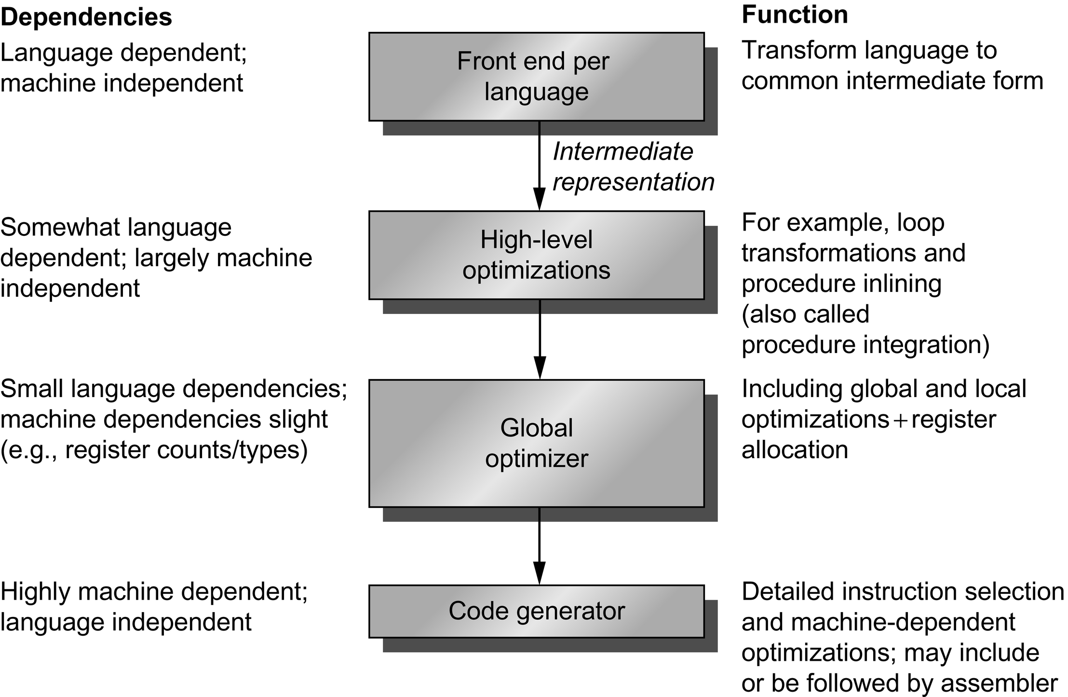
Figure A.19 Compilers typically consist of two to four passes, with more highly optimizing compilers having more passes. This structure maximizes the probability that a program compiled at various levels of optimization will produce the same output when given the same input. The optimizing passes are designed to be optional and may be skipped when faster compilation is the goal and lower-quality code is acceptable. A pass is simply one phase in which the compiler reads and transforms the entire program. (The term phase is often used interchangeably with pass.) Because the optimizing passes are separated, multiple languages can use the same optimizing and code generation passes. Only a new front end is required for a new language.

Slide 21
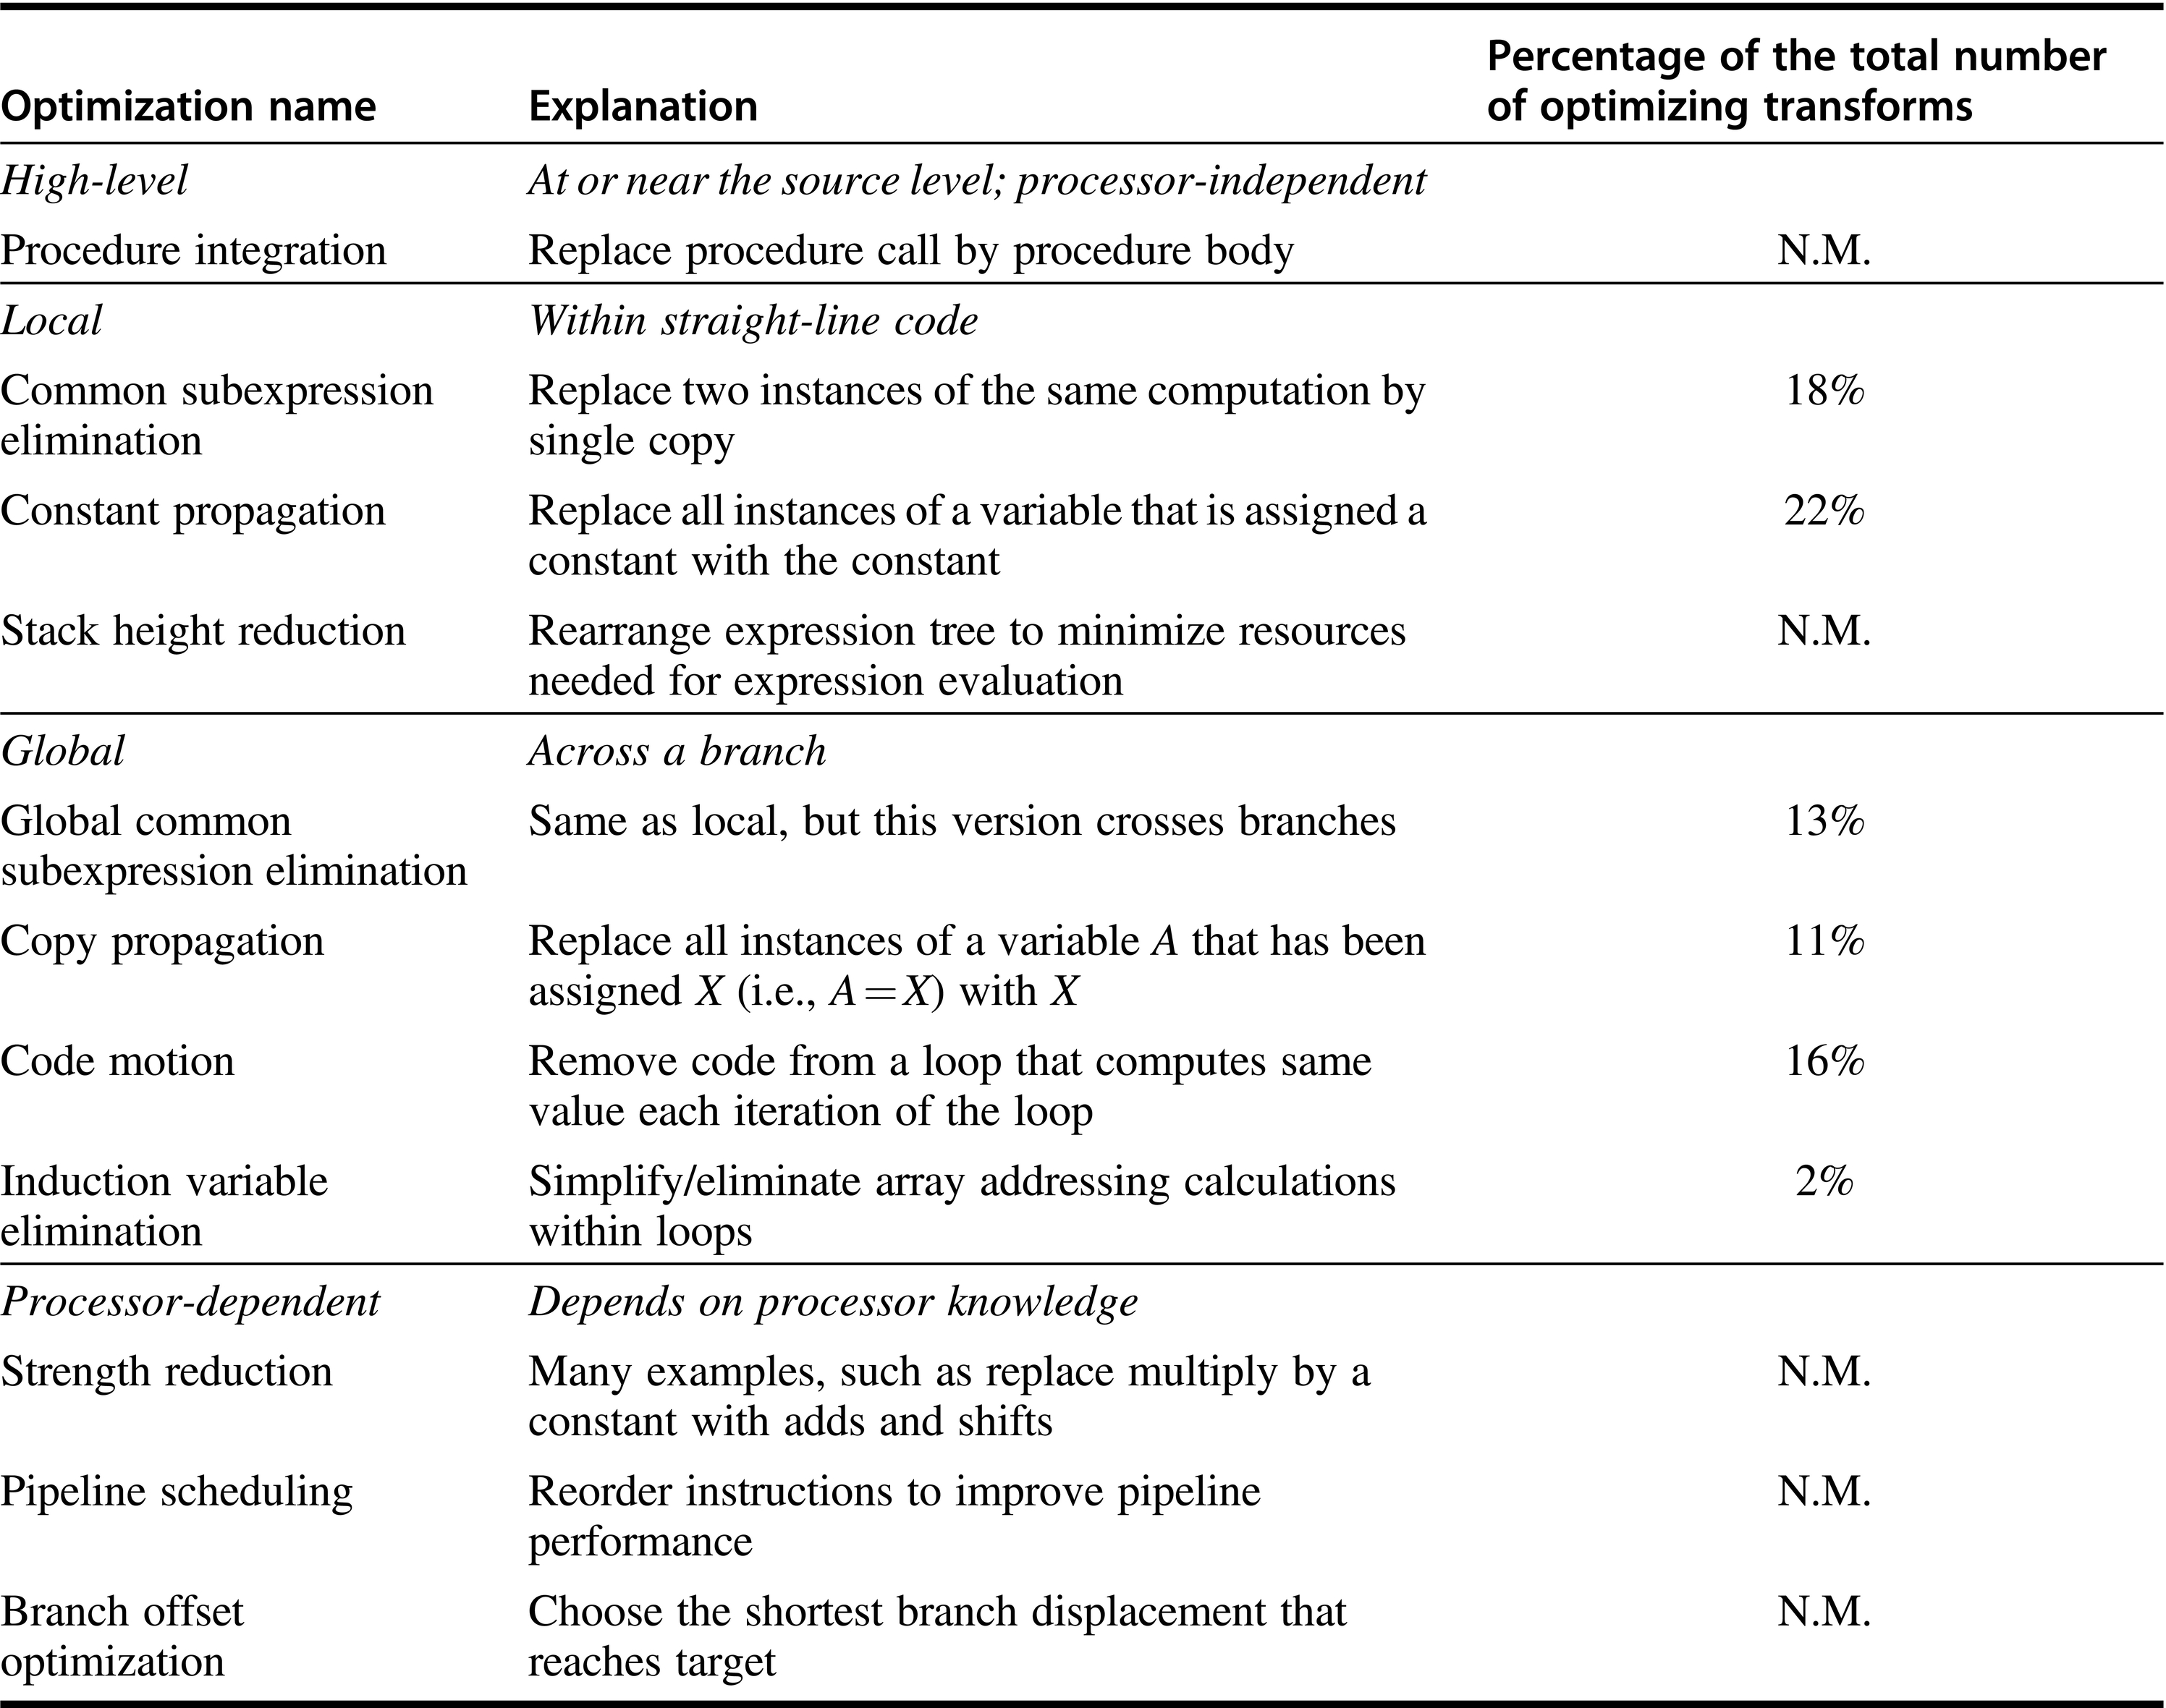
Figure A.20 Major types of optimizations and examples in each class. These data tell us about the relative frequency of occurrence of various optimizations. The third column lists the static frequency with which some of the common optimizations are applied in a set of 12 small Fortran and Pascal programs. There are nine local and global optimizations done by the compiler included in the measurement. Six of these optimizations are covered in the figure, and the remaining three account for 18% of the total static occurrences. The abbreviation N.M. means that the number of occurrences of that optimization was not measured. Processor-dependent optimizations are usually done in a code generator, and none of those was measured in this experiment. The percentage is the portion of the static optimizations that are of the specified type. Data from Chow, F.C., 1983. A Portable Machine-Independent Global Optimizer—Design and Measurements (Ph.D. thesis). Stanford University, Palo Alto, CA (collected using the Stanford UCODE compiler).

Slide 22
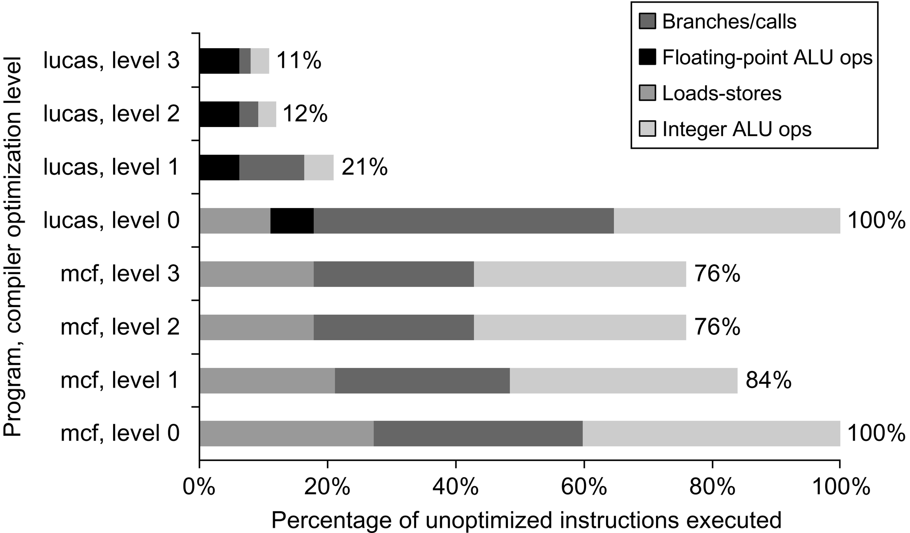
Figure A.21 Change in instruction count for the programs lucas and mcf from the SPEC2000 as compiler optimization levels vary. Level 0 is the same as unoptimized code. Level 1 includes local optimizations, code scheduling, and local register allocation. Level 2 includes global optimizations, loop transformations (software pipelining), and global register allocation. Level 3 adds procedure integration. These experiments were performed on Alpha compilers.

Slide 23
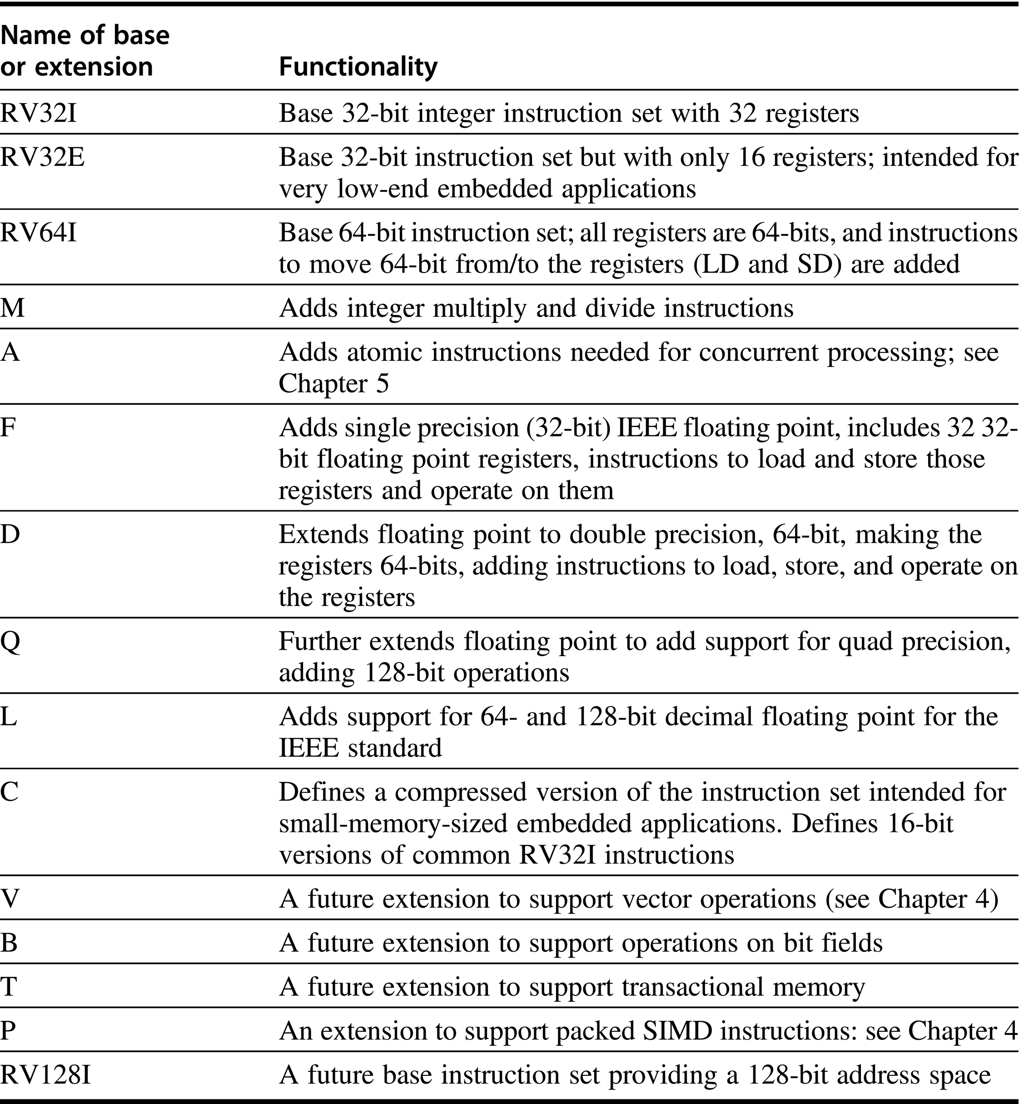
Figure A.22 RISC-V has three base instructions sets (and a reserved spot for a future fourth); all the extensions extend one of the base instruction sets. An instruction set is thus named by the base name followed by the extensions. For example, RISC-V64IMAFD refers to the base 64-bit instruction set with extensions M, A, F, and D. For consistency of naming and software, this combination is given the abbreviated name: RV64G, and we use RV64G through most of this text.

Slide 24
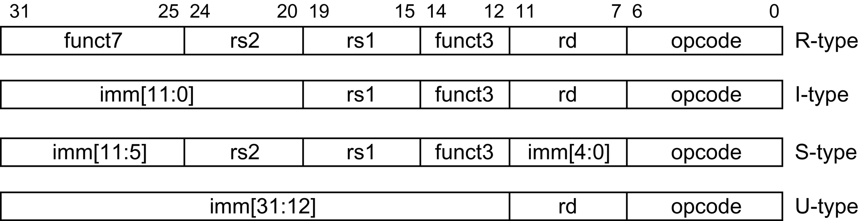
Figure A.23 The RISC-V instruction layout. There are two variations on these formata, called the SB and UJ formats; they deal with a slightly different treatment for immediate fields.

Slide 25
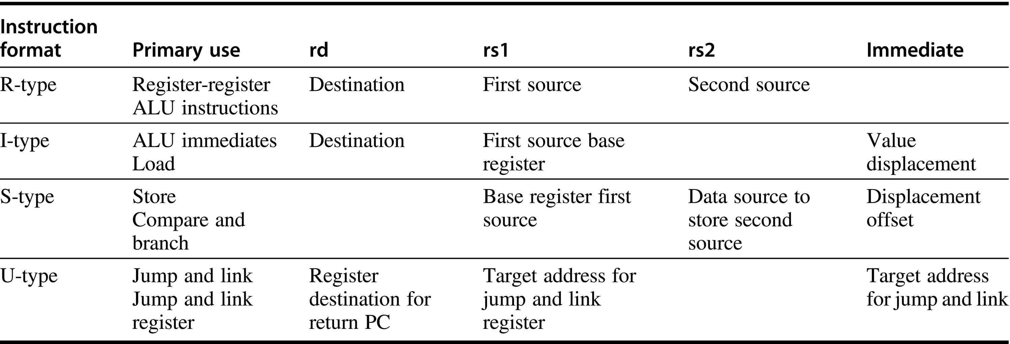
Figure A.24 The use of instruction fields for each instruction type. Primary use shows the major instructions that use the format. A blank indicates that the corresponding field is not present in this instruction type. The I-format is used for both loads and ALU immediates, with the 12-bit immediate holding either the value for an immediate or the displacement for a load. Similarly, the S-format encodes both store instructions (where the first source register is the base register and the second contains the register source for the value to store) and compare and branch instructions (where the register fields contain the sources to compare and the immediate field specifies the offset of the branch target). There are actually two other formats: SB and UJ that follow the same basic organization as S and J, but slightly modify the interpretation of the immediate fields.

Slide 26
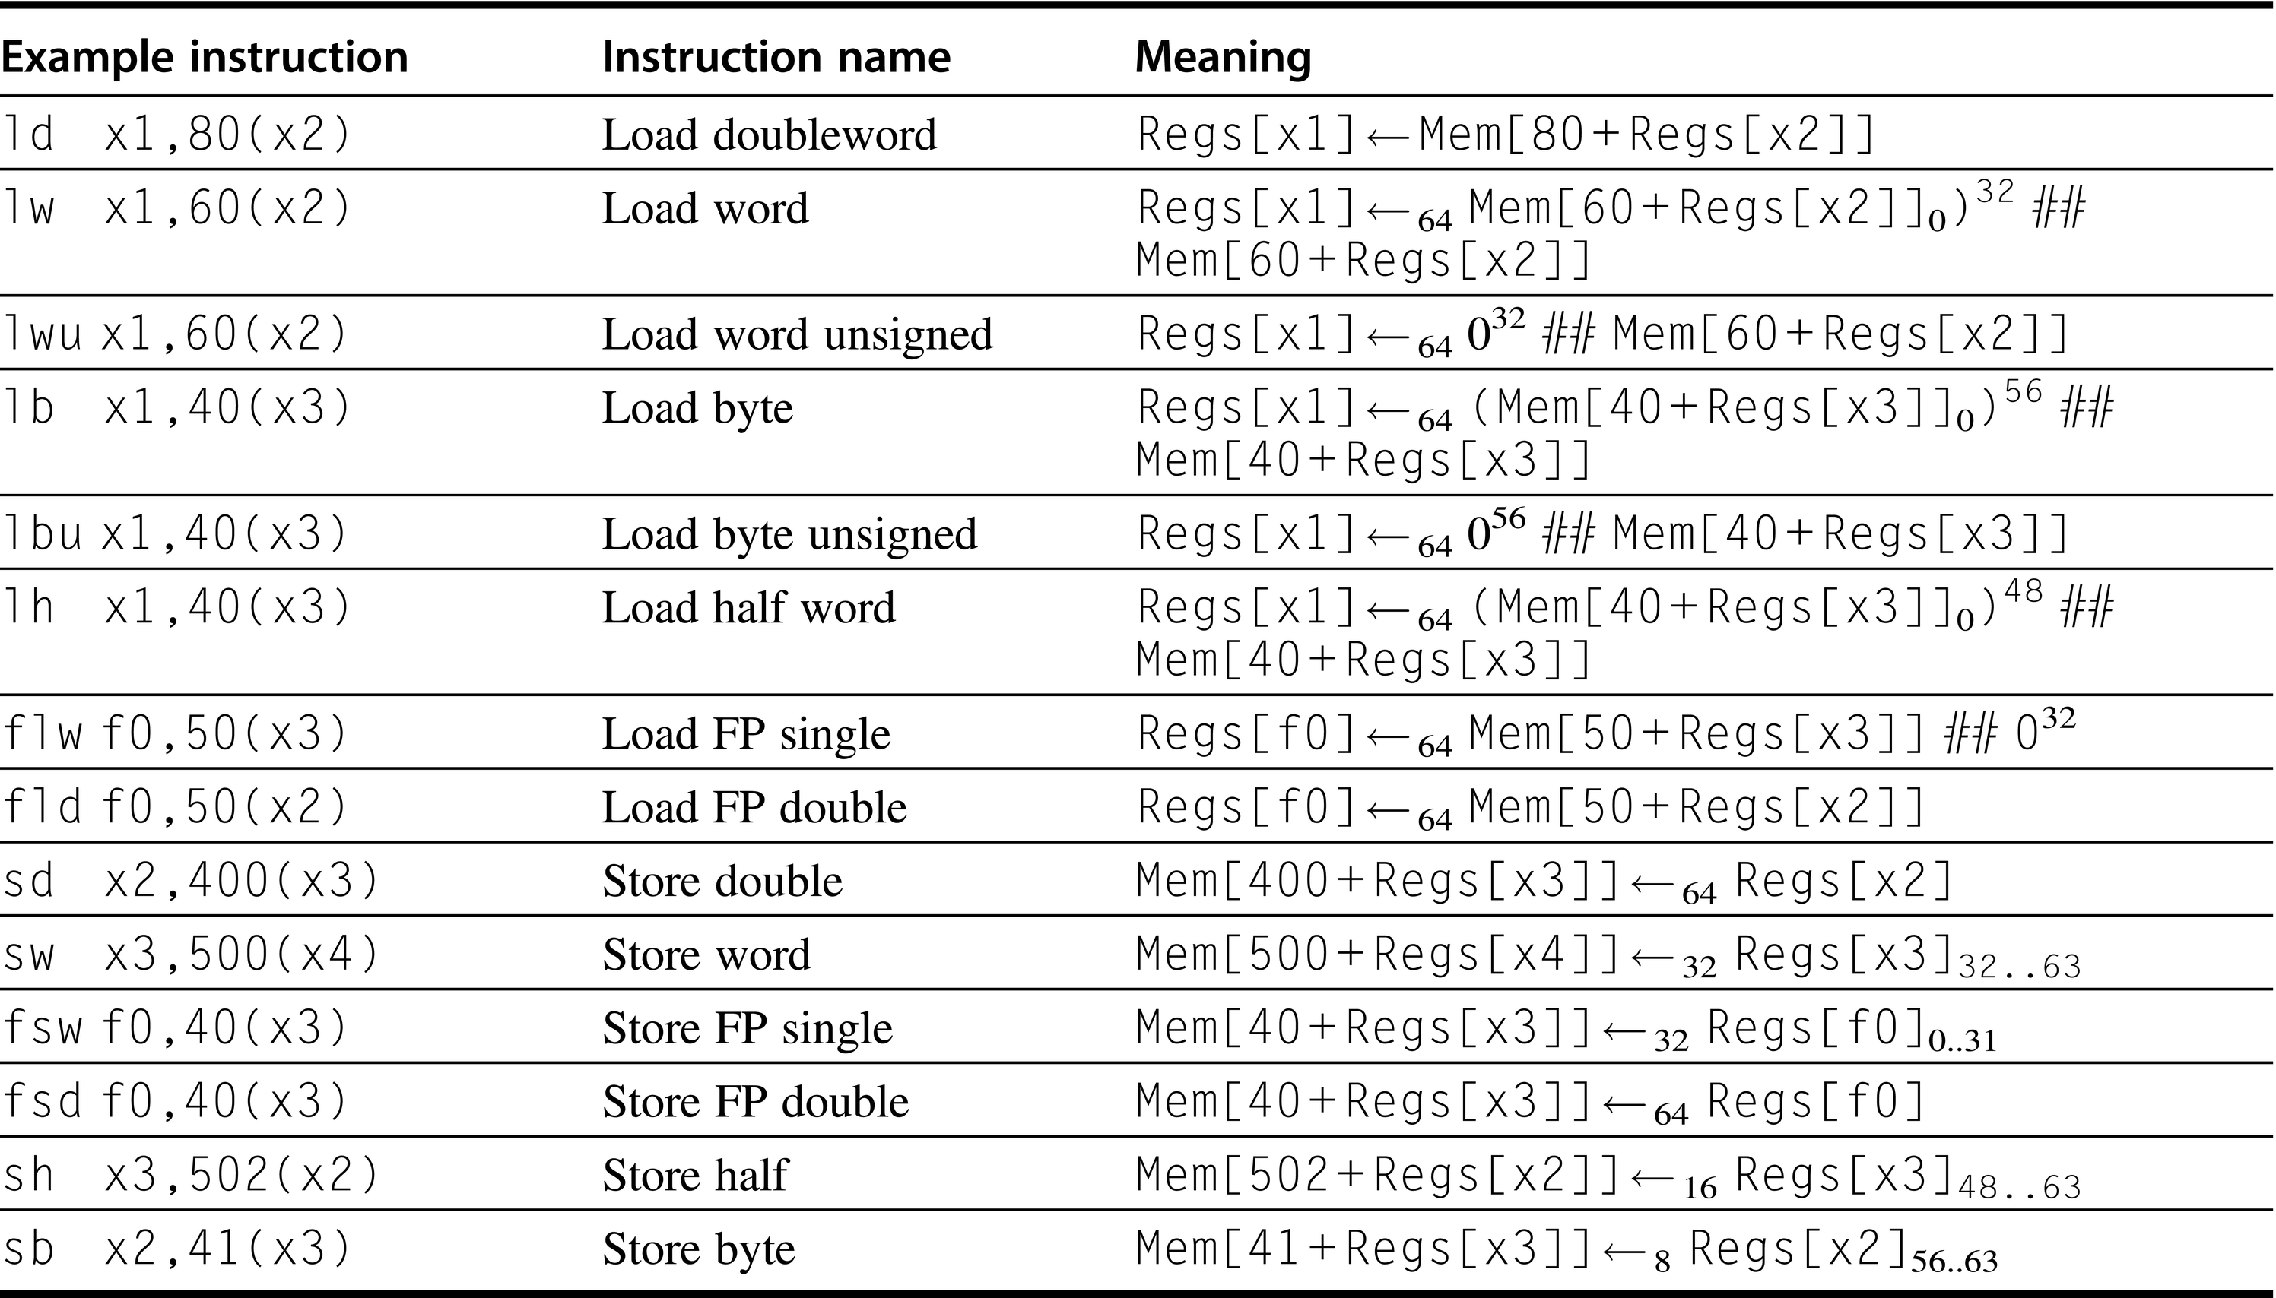
Figure A.25 The load and store instructions in RISC-V. Loads shorter than 64 bits are available in both sign-extended and zero-extended forms. All memory references use a single addressing mode. Of course, both loads and stores are available for all the data types shown. Because RV64G supports double precision floating point, all single precision floating point loads must be aligned in the FP register, which are 64-bits wide.

Slide 27
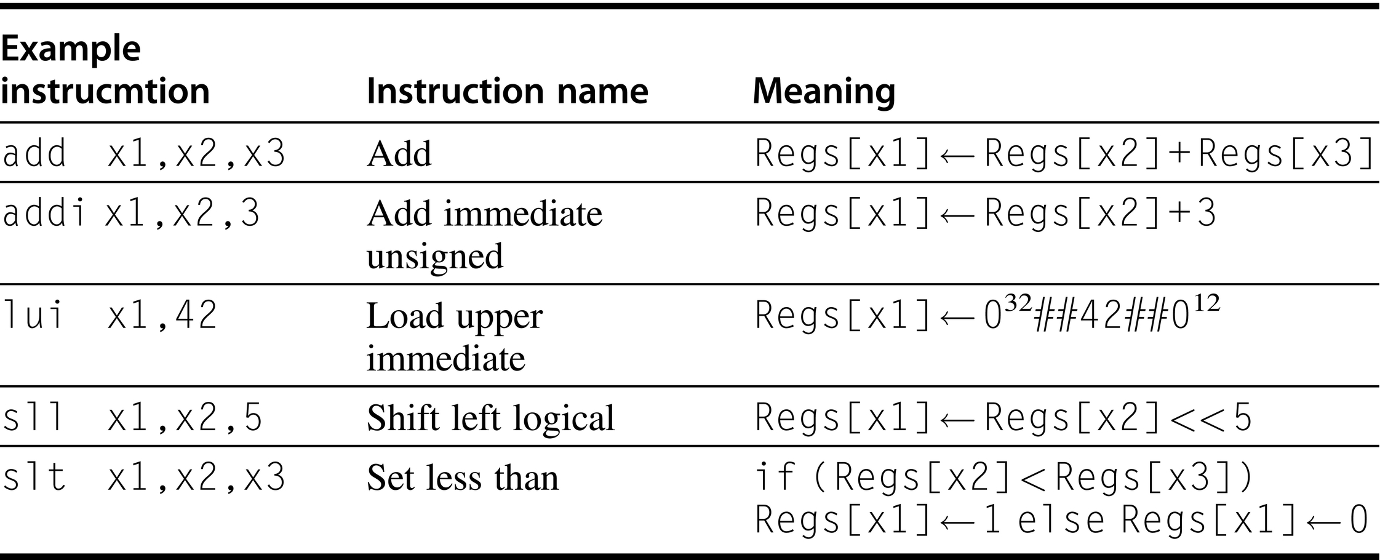
Figure A.26 The basic ALU instructions in RISC-V are available both with register-register operands and with one immediate operand. LUI uses the U-format that employs the rs1 field as part of the immediate, yielding a 20-bit immediate.

Slide 28
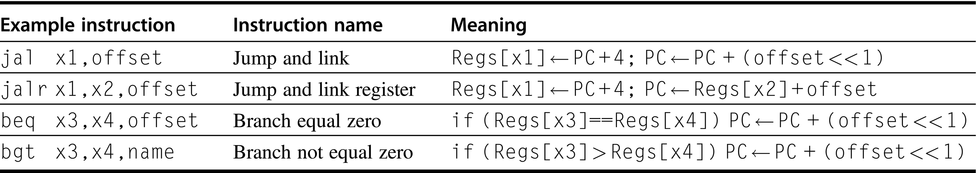
Figure A.27 Typical control flow instructions in RISC-V. All control instructions, except jumps to an address in a register, are PC-relative.

Slide 29
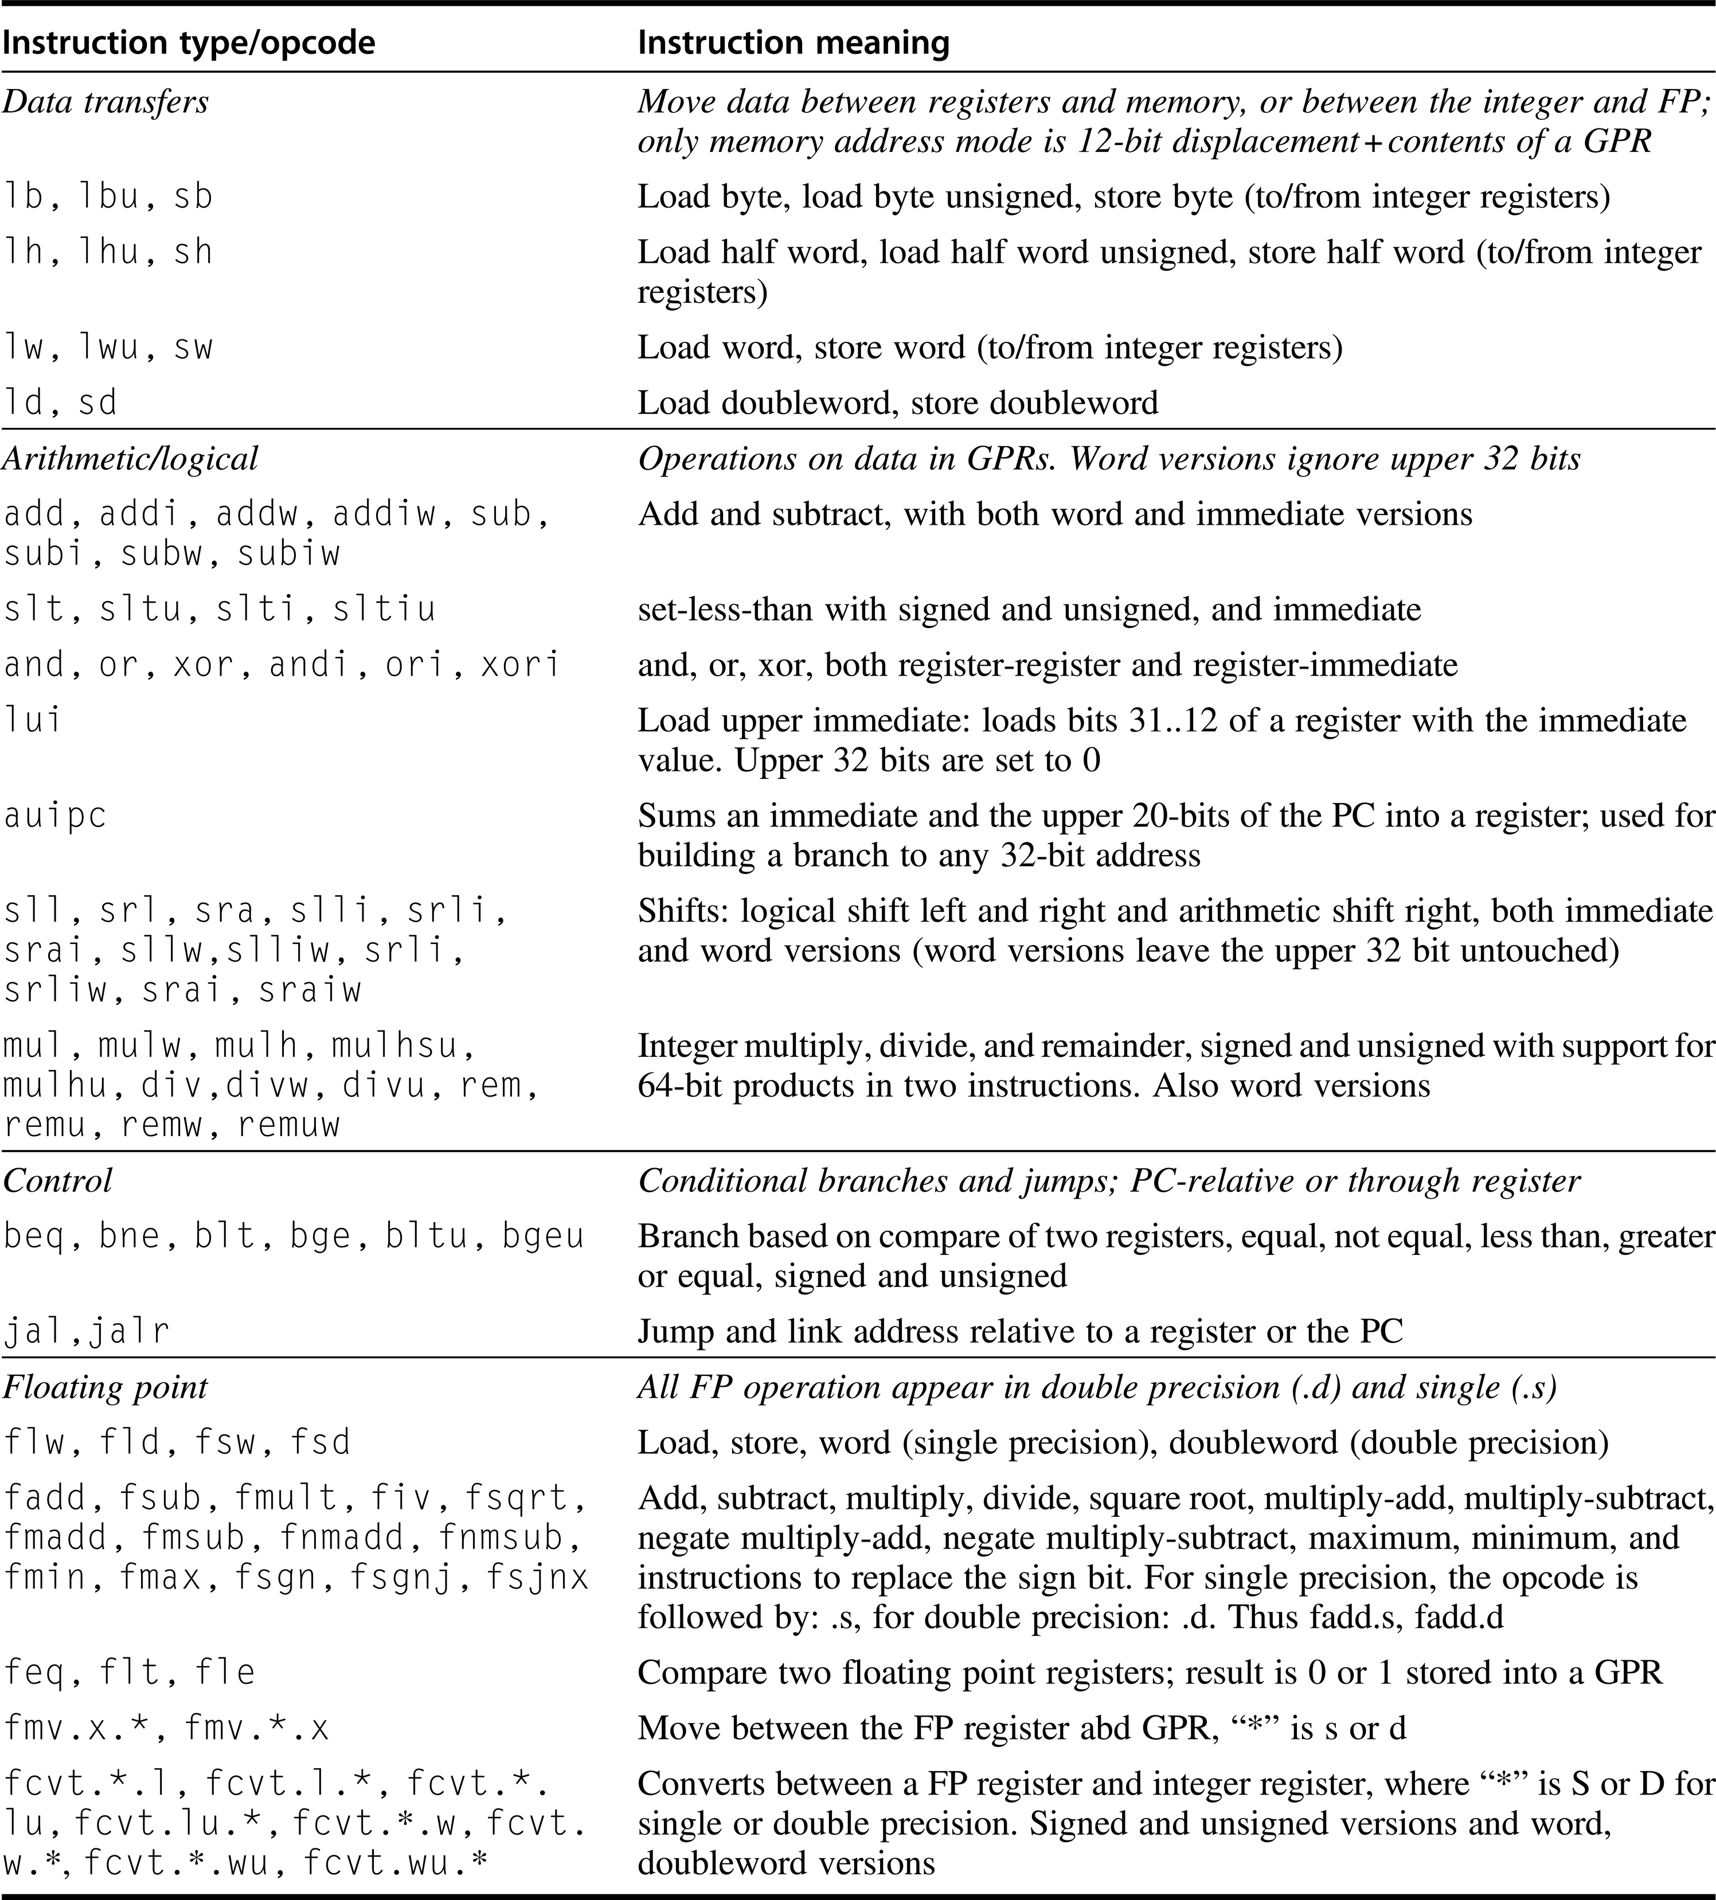
Figure A.28 A list of the vast majority of instructions in RV64G. This list can also be found on the back inside cover. This table omits system instructions, synchronization and atomic instructions, configuration instructions, instructions to reset and access performance counters, about 10 instructions in total.

Slide 30
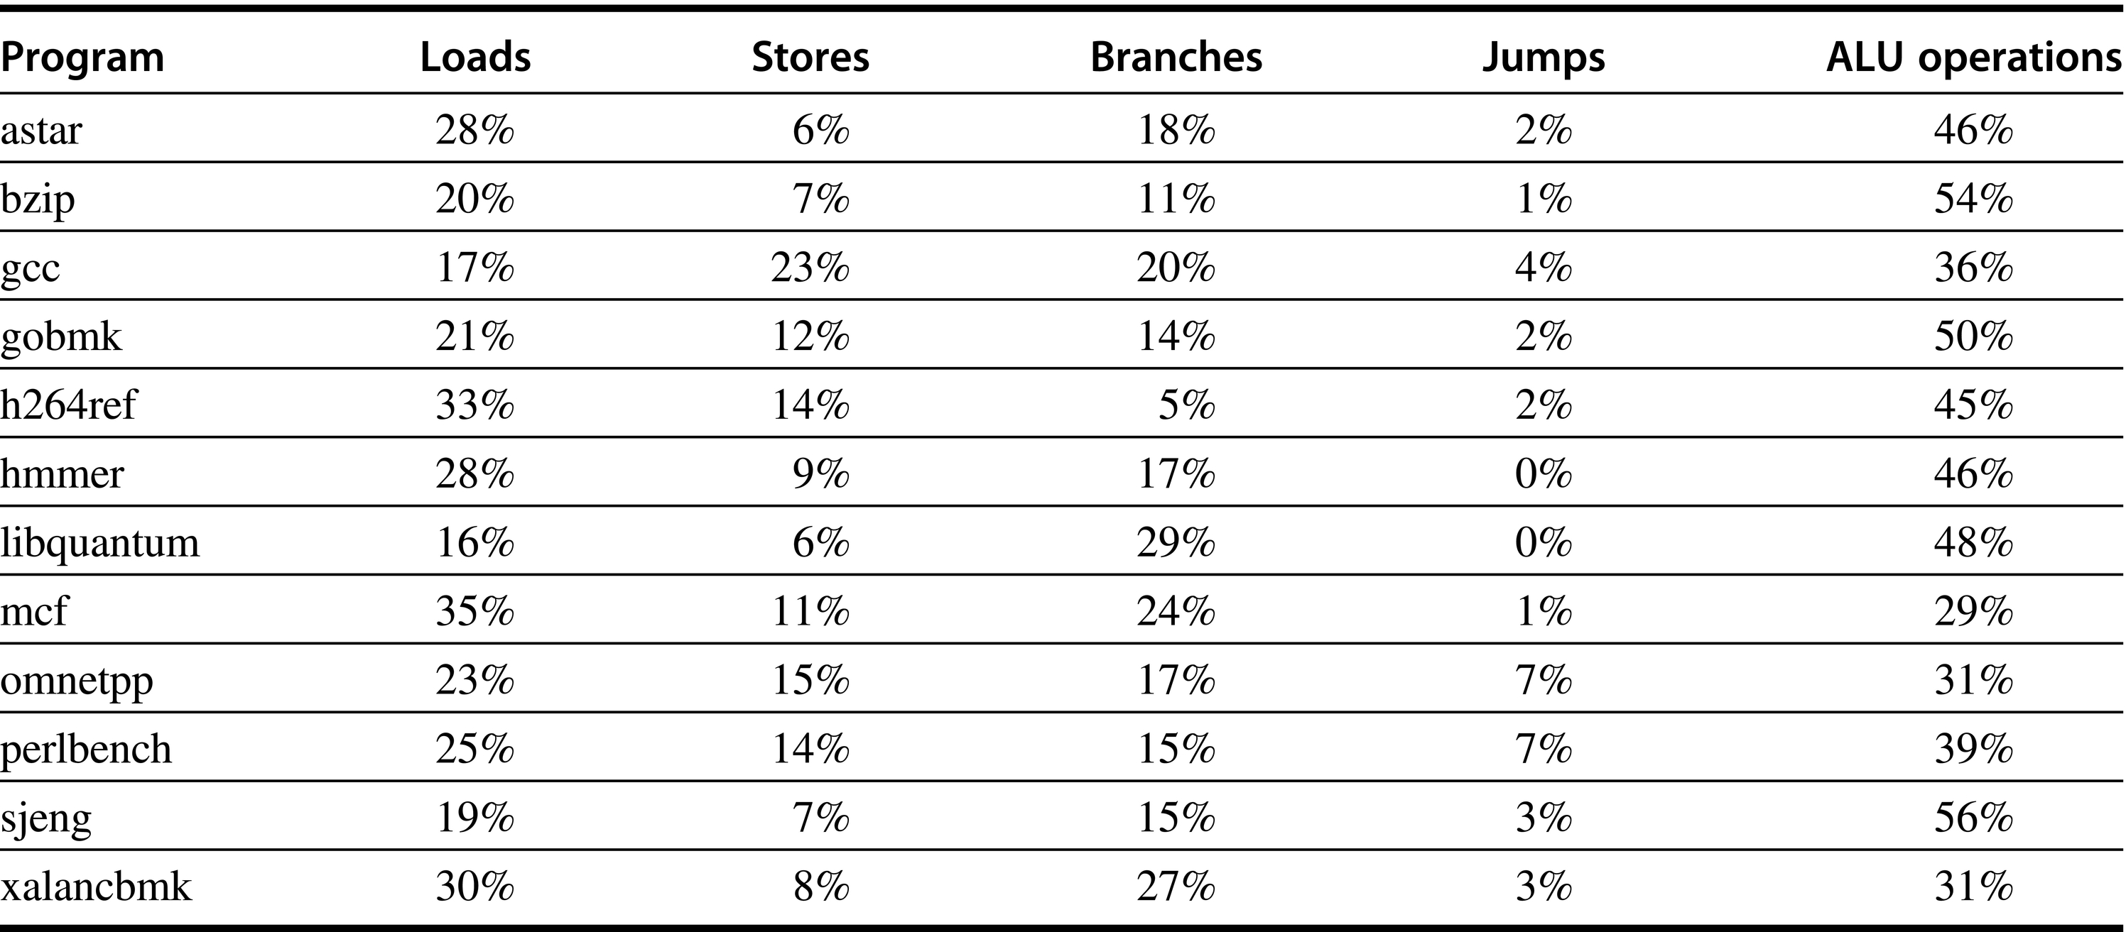
Figure A.29 RISC-V dynamic instruction mix for the SPECint2006 programs. Omnetpp includes 7% of the instructions that are floating point loads, stores, operations, or compares; no other program includes even 1% of other instruction types. A change in gcc in SPECint2006, creates an anomaly in behavior. Typical integer programs have load frequencies that are 1/5 to 3x the store frequency. In gcc, the store frequency is actually higher than the load frequency! This arises because a large fraction of the execution time is spent in a loop that clears memory by storing x0 (not where a compiler like gcc would usually spend most of its execution time!). A store instruction that stores a register pair, which some other RISC ISAs have included, would address this issue.

Slide 31
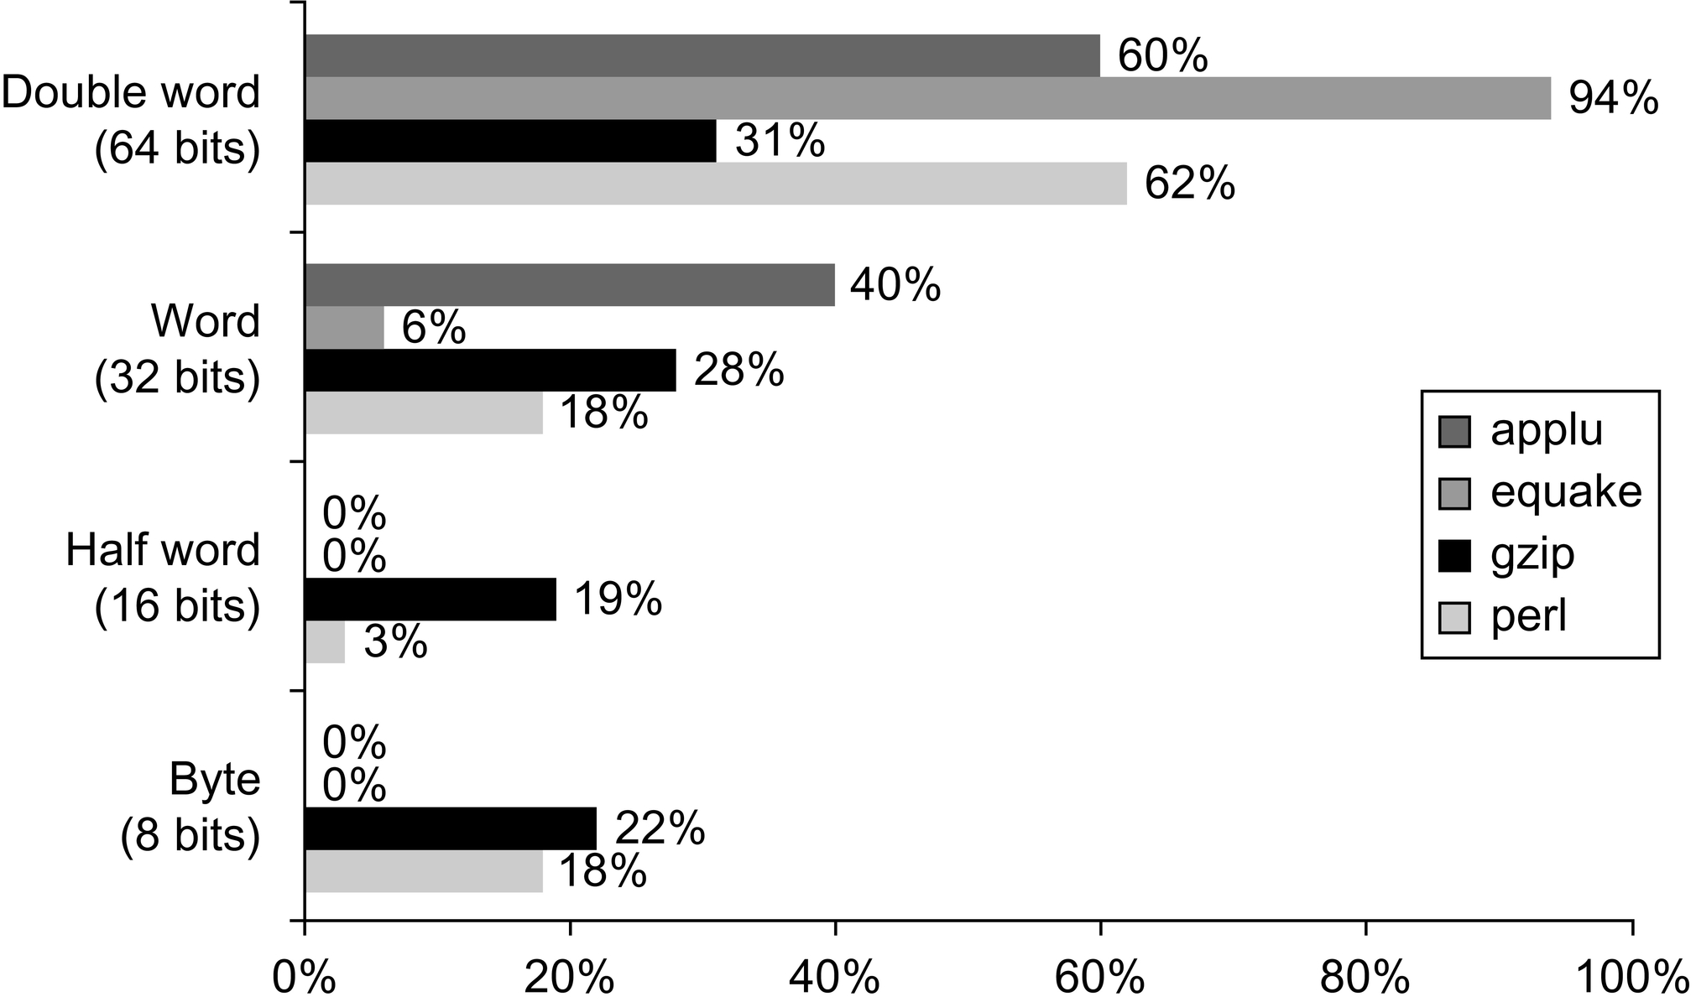
Figure A.30 Data reference size of four programs from SPEC2000. Although you can calculate an average size, it would be hard to claim the average is typical of programs.

Slide 32
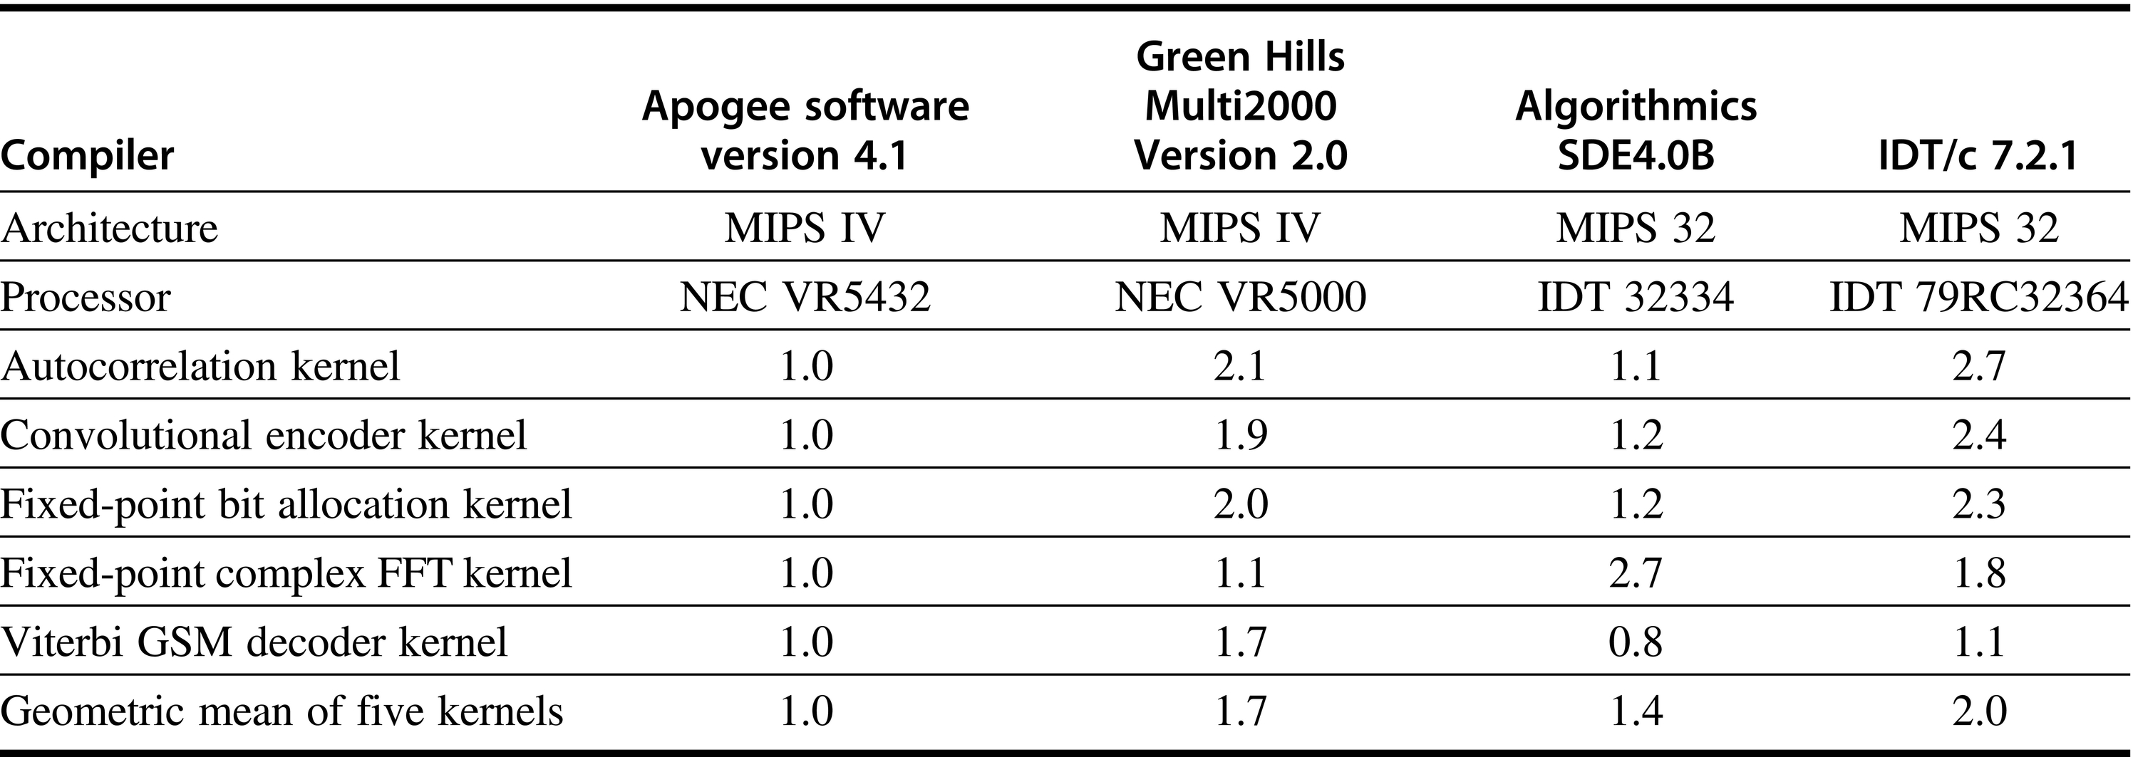
Figure A.31 Code size relative to Apogee Software Version 4.1 C compiler for Telecom application of EEMBC benchmarks. The instruction set architectures are virtually identical, yet the code sizes vary by factors of 2. These results were reported February–June 2000.

